Slide 1
Cloud Computing and Data Security
Dr. Oluwasegun I. Adelaiye

Slide 2
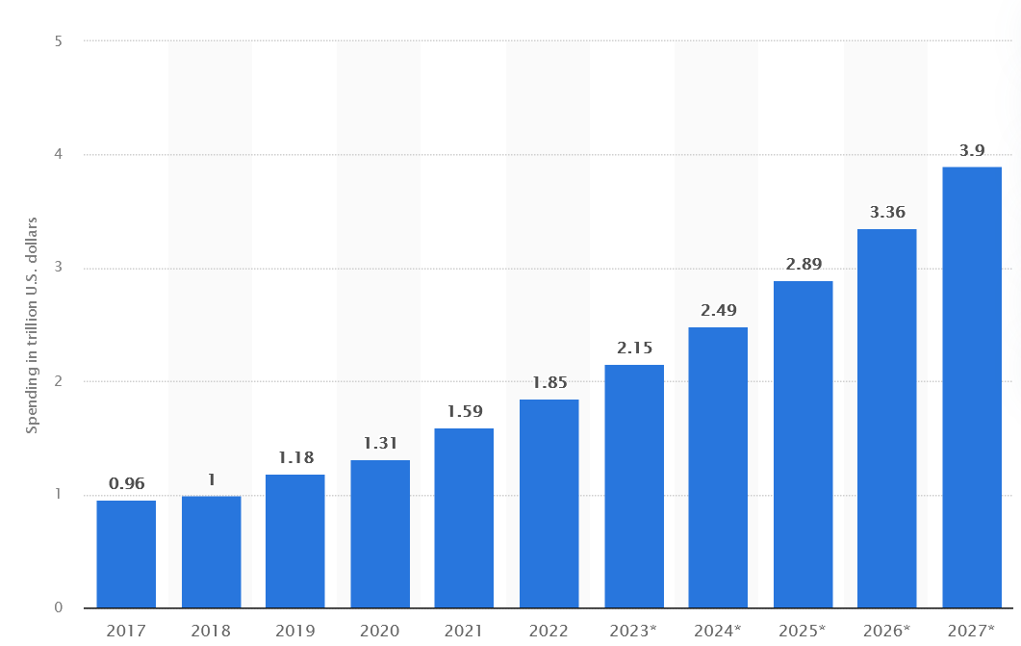
Computing
In a world moving fast towards full digitization
Nigeria also moving towards digital transformation

Slide 3
Revolutionizing Computing
As we need more computing resources to deal with todays problems.
We have the opportunity of using remote computing resources through the internet. CLOUD COMPUTING
Cloud computing
  the delivery of computing services including servers, storage, databases, networking, software, analytics, and intelligence over the Internet (“the cloud”) to offer faster innovation and flexible resources.

Slide 4
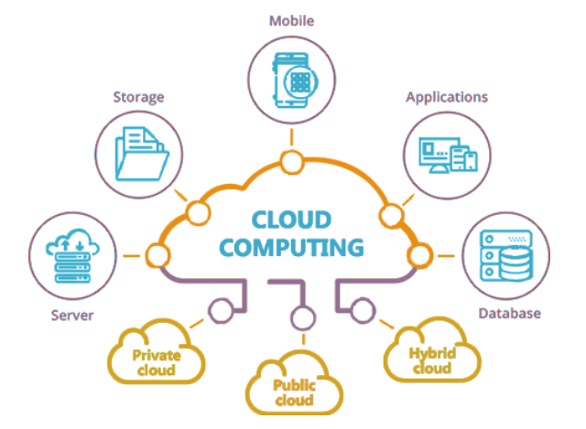

Slide 5
Cloud Computing Characteristics
On-demand Self-Service: Users can provision computing resources as needed without requiring human interaction with each service’s provider.
Broad Network Access: Services are available over the network and accessed through standard mechanisms that promote use by heterogeneous thin or thick client platforms (e.g., mobile phones, tablets, laptops, and workstations).
Resource Pooling: Cloud providers serve multiple customers using a multi-tenant model, with different physical and virtual resources dynamically assigned and reassigned according to demand.

Slide 6
Cloud Computing Characteristics
Rapid Elasticity: Capabilities can be elastically provisioned and released to scale rapidly outward and inward commensurate with demand.
Measured Service: Cloud systems automatically control and optimize resource use by leveraging a metering capability at some level of abstraction appropriate to the type of service (e.g., storage, processing, bandwidth).

Slide 7
Types of Cloud Computing
Public Cloud: Services are delivered over the public Internet and shared across organizations.
Private Cloud: Services are maintained on a private network and used by a single organization.
Hybrid Cloud: Combines public and private clouds, bound together by technology that allows data and applications to be shared between them.
Community Cloud: Shared infrastructure for a specific community.

Slide 8
Cloud Computing Service Models
Infrastructure as a Service (IaaS): Provides virtualized computing resources over the Internet. Examples include AWS EC2, Google Compute Engine.
Platform as a Service (PaaS): Delivers hardware and software tools over the Internet. Examples include Google App Engine, Microsoft Azure.
Software as a Service (SaaS): Delivers software applications over the Internet, on a subscription basis. Examples include Salesforce, Microsoft Office 365.
Anything as a Service (XaaS)

Slide 9
Benefits
Cost Efficiency: Reduces the need for physical hardware, lowering maintenance and electricity costs.
Scalability: Easily scale up or down based on demand.
Flexibility: Access from anywhere with an Internet connection.
Accessibility: Facilitates collaboration and access to applications and data globally.
Disaster Recovery: Provides backup and recovery solutions, ensuring business continuity.

Slide 10
Challenges
Security and Privacy: Concerns about data breaches and privacy issues.
Downtime and Reliability: Dependence on Internet connection and service providers' reliability.
Limited Control: Users have limited control over infrastructure managed by third-party providers.
Data Transfer Costs: Potential high costs for transferring large amounts of data.

Slide 11
Popular Service Providers
Amazon Web Services (AWS)
Microsoft Azure
Google Cloud Platform (GCP)
IBM Cloud

Slide 12
Applications of Cloud Computing
Cloud Storage: Dropbox, Google Drive
Cloud Hosting: WordPress, Wix
Cloud-Based Software: Salesforce, Office 365
Big Data and Analytics: Hadoop, Spark

Slide 13
Future Trends
Edge Computing: Bringing computation and data storage closer to the data source.
Serverless Architectures: Building and running applications without managing infrastructure.
AI and Machine Learning Integration: Leveraging AI and ML for enhanced cloud services.
Quantum Computing: Utilizing quantum computing for solving complex problems faster than traditional computing.

Slide 14
Cloud Computing meets Data Security

Slide 15
Data out there
Source: Exploding Topics

Slide 16
Source: Exploding Topics

Slide 17
Security Challenges In Cloud Computing
Data Breaches
Insecure APIs (Application Programming Interfaces)
Compliance and Regulatory Issues
Data Loss

Slide 18
Safeguarding Information in the Digital Age

Slide 19
Data Security
The practice of protecting digital information from
  unauthorized access
  Corruption
  Theft
It encompasses a variety of strategies and technologies designed to ensure that data remains confidential, intact, and accessible to authorized users

Slide 20
Data Security
Key elements
  Encryption
  Access controls
  Authentication
  Secure data storage
  Transmission methods.

Slide 21
Mitigation Strategies For Security Challenges with Cloud
Data Encryption
Multi-Factor Authentication (MFA)
Regular Security Audits
Employee Training

Slide 22
Regulatory Compliance
GDPR (General Data Protection Regulation)
HIPAA (Health Insurance Portability and Accountability Act)
CCPA (California Consumer Privacy Act)
PCIDSS (Payment Card Industry Data Security Standard)
Amongs others
Our own regulatory body
  Nigeria Data Protection Commission

Slide 23
Future Directions
As cloud computing continues to evolve, new security challenges will emerge
Future research should focus on:
  Developing advanced security frameworks that incorporate artificial intelligence and machine learning to predict and mitigate threats in real-time
  Additionally, exploring the implications of quantum computing on cloud security will be vital as this technology matures.

Slide 24
THANK YOU

