Slide 1



Health Management Professionals and National Development
Professor Imran O. Morhason-Bello
MBBS(Ib), MSc Rep Biol(Ib); MPH(Liverpool), PhD(London), MD, FWACS, FMCOG, FICS
​Department of Obstetrics and Gynaecology, Faculty of Clinical Sciences,
College of Medicine, University of Ibadan and University College Hospital
Ibadan, Nigeria.

Slide 2

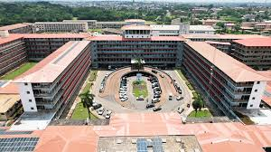
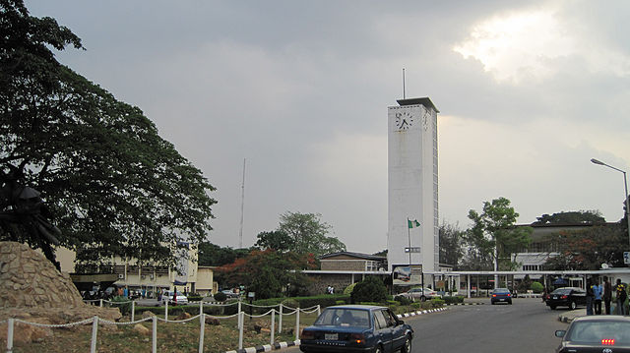
Special Greetings from my base!
University of Ibadan, Nigeria
University College Hospital, Ibadan

Slide 3
Acknowledgements
Leadership of Applied Information Management Professionals
Esther Ikomi

Slide 4
Outline
Background
  Definition of health
  Social determinant of health
  Health systems
  Health Management Professionals
Indicators for National Development
  Nigeria as a case study
Health management professionals responsibilities and ND
Recommendations
Take home messages

Slide 5
Background – Health is unique
Health has evolved from an individual one-on-one service to complex systems organized within financing arrangements, mostly under government auspices
Health systems are complex organizations and their management is an important concept in the New Public Health.
Health is a major sector of any economy and often employs more people in the industrialized countries than any other industry.
Health has complex networks of services and provider agencies, including funding through public or private insurance or through national health service systems.
  Whether insurance is provided by the state or through private and public sources combined, skilled management is required at the macro- or national and the micro- or local level, including the many institutions that make up the system.

Slide 6
Health service is a unique sector
Health services are fundamental to society and the economy, with health care recognized as a basic human right essential for safeguarding the health and safety of populations.
There is no health care without health workers.
Securing employment and decent working conditions for health workers are essential strategies to ensure equal access to quality health services and to address global health workforce shortages.

Slide 7
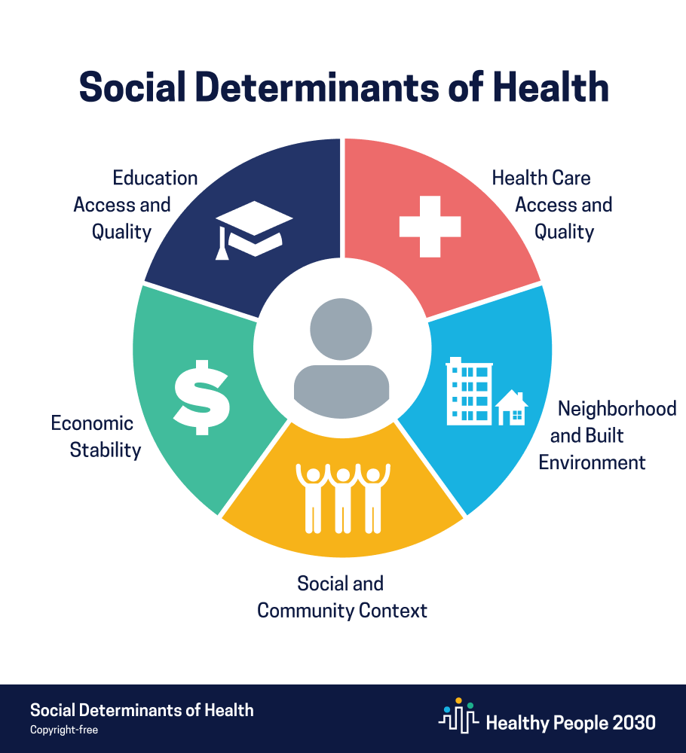
Social determinants of Health
The social determinants of health (SDH) are the non-medical factors that influence health outcomes.
  They are the conditions in which people are born, grow, work, live, and age, and the wider set of forces and systems shaping the conditions of daily life.
These forces and systems include economic policies and systems, development agendas, social norms, social policies and political systems
The SDH have an important influence on health inequities - the unfair and avoidable differences in health status seen within and between countries
In countries at all levels of income, health and illness follow a social gradient: the lower the socioeconomic position, the worse the health

Slide 8

SDH is an important marker of National Development

Slide 9
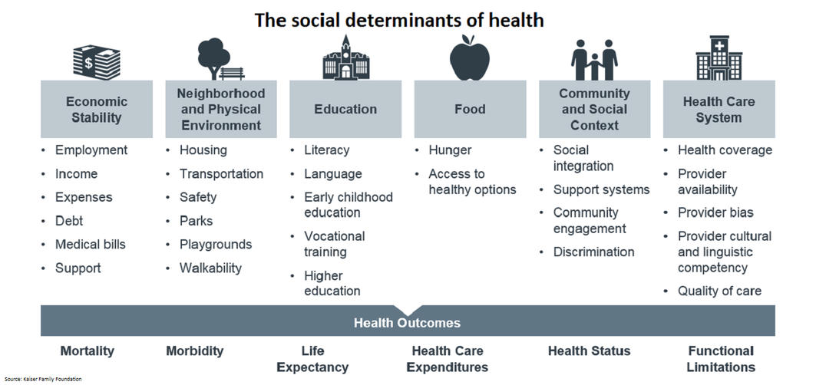

Slide 10
Social Health Protection
The ILO promotes a rights-based approach to social health protection, with the objective of ensuring effective access to quality health care without hardship and impoverishment.
This rights-based approach is rooted in the body of human rights and ILO standards which represent a global consensus to guide the development of social health protection systems.

Slide 11
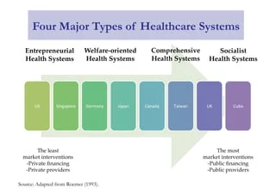
Health system
The expertise, structure, and organization that make possible the delivery of health services nationwide, comprising
  leadership and governance;
  human resources for health;
  financial management;
  health information;
  management of medicines;
  health service delivery

Slide 12
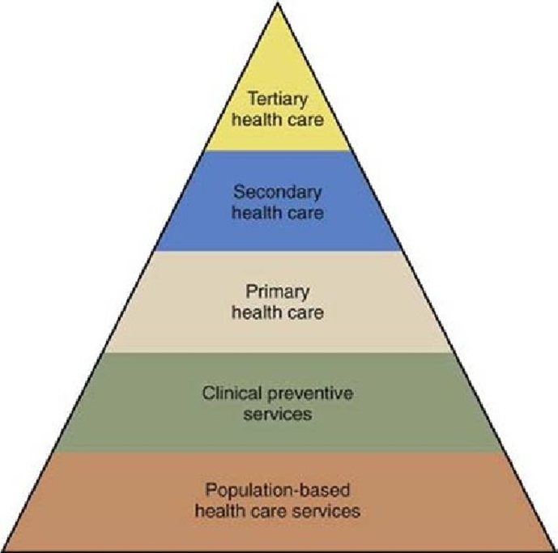

Slide 13
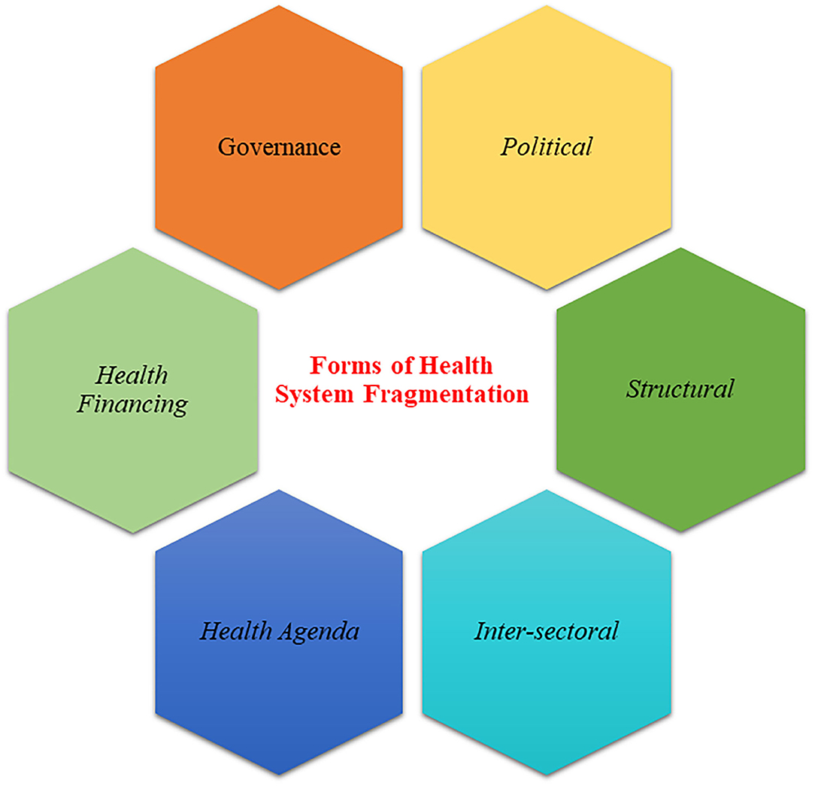
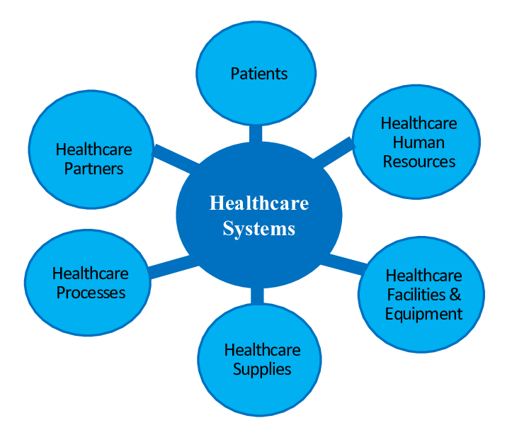
Health systems in focus
The main components of a healthcare system

Slide 14


Slide 15
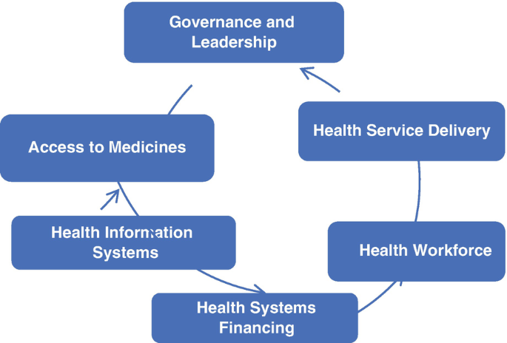
The governance structure – wheel & spoke approach

Slide 16
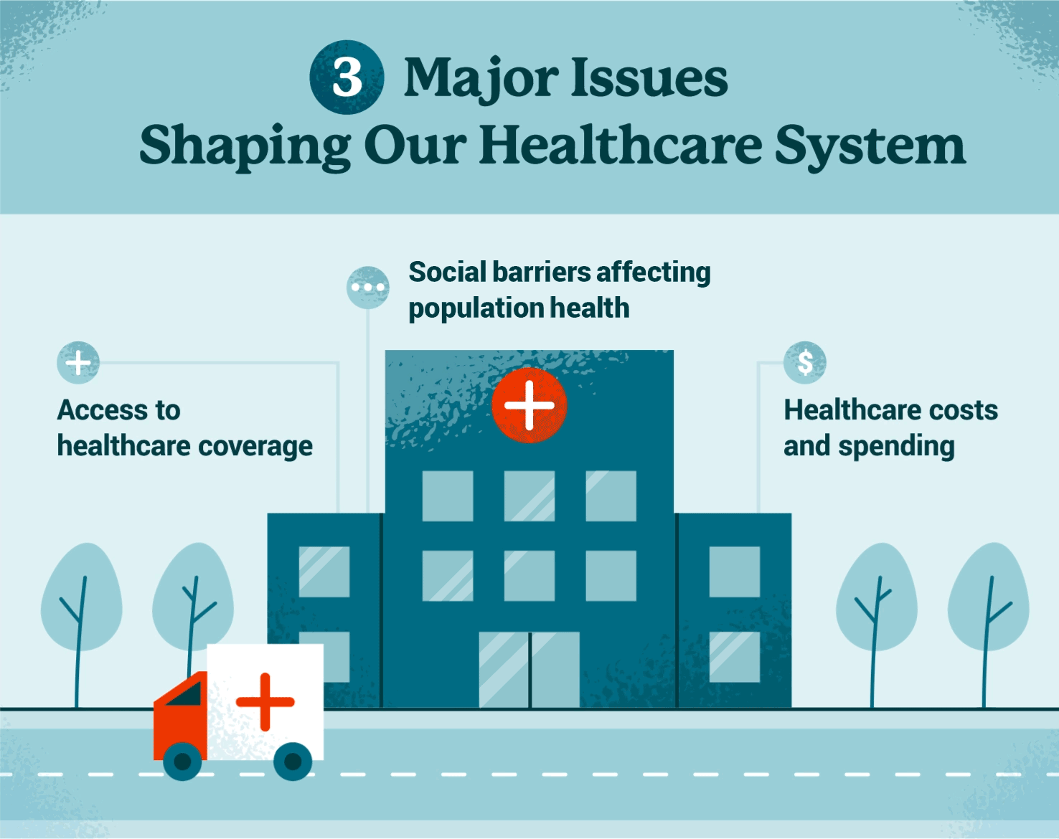

Slide 17
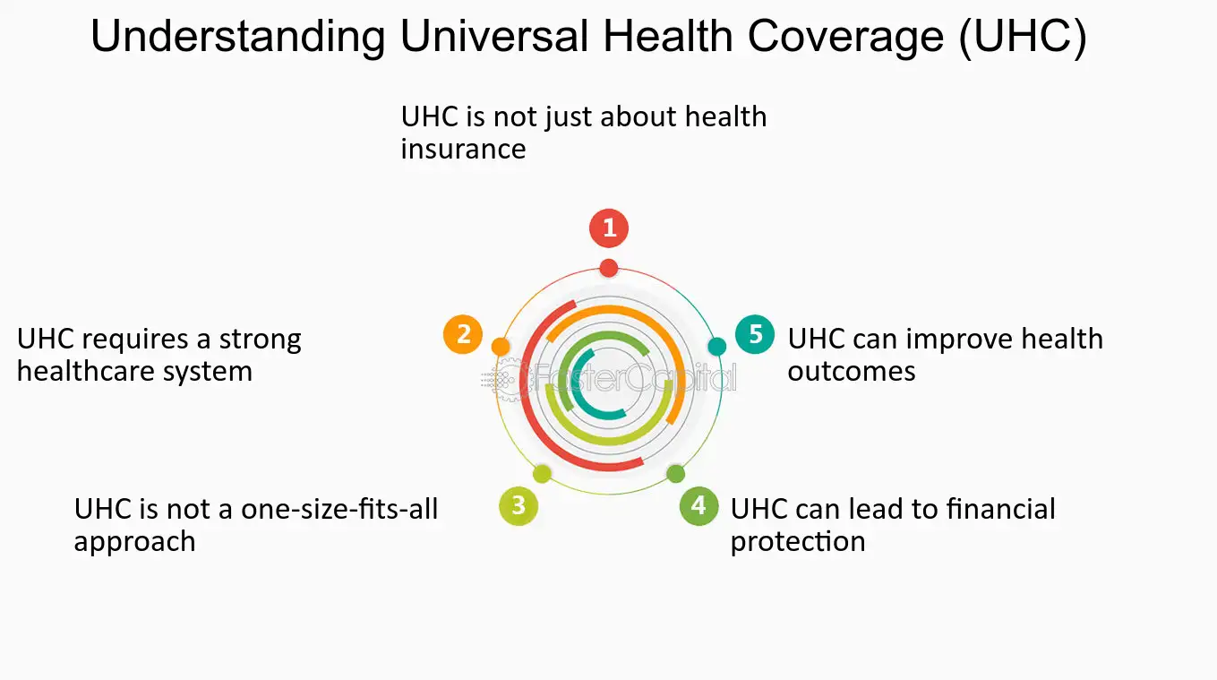
The ultimate is to achieve UHC

Slide 18


Slide 19
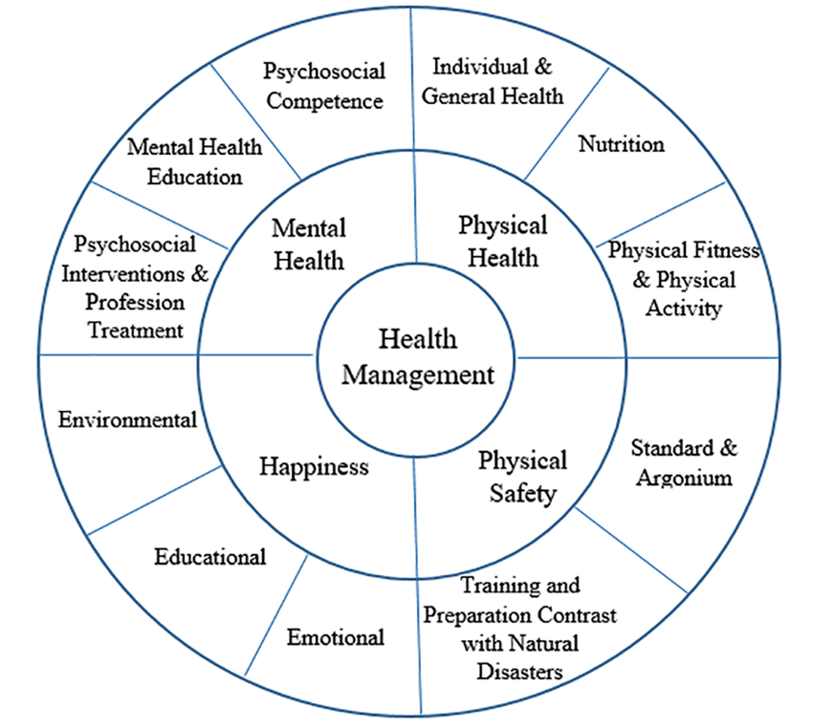
Health Management is crucial
Health management is critical for improving performance, efficiency, and effectiveness of health systems and health programs, thereby improved access and availability of high-quality and affordable health care with a focus on reducing inequities and raising health status of the people

Slide 20
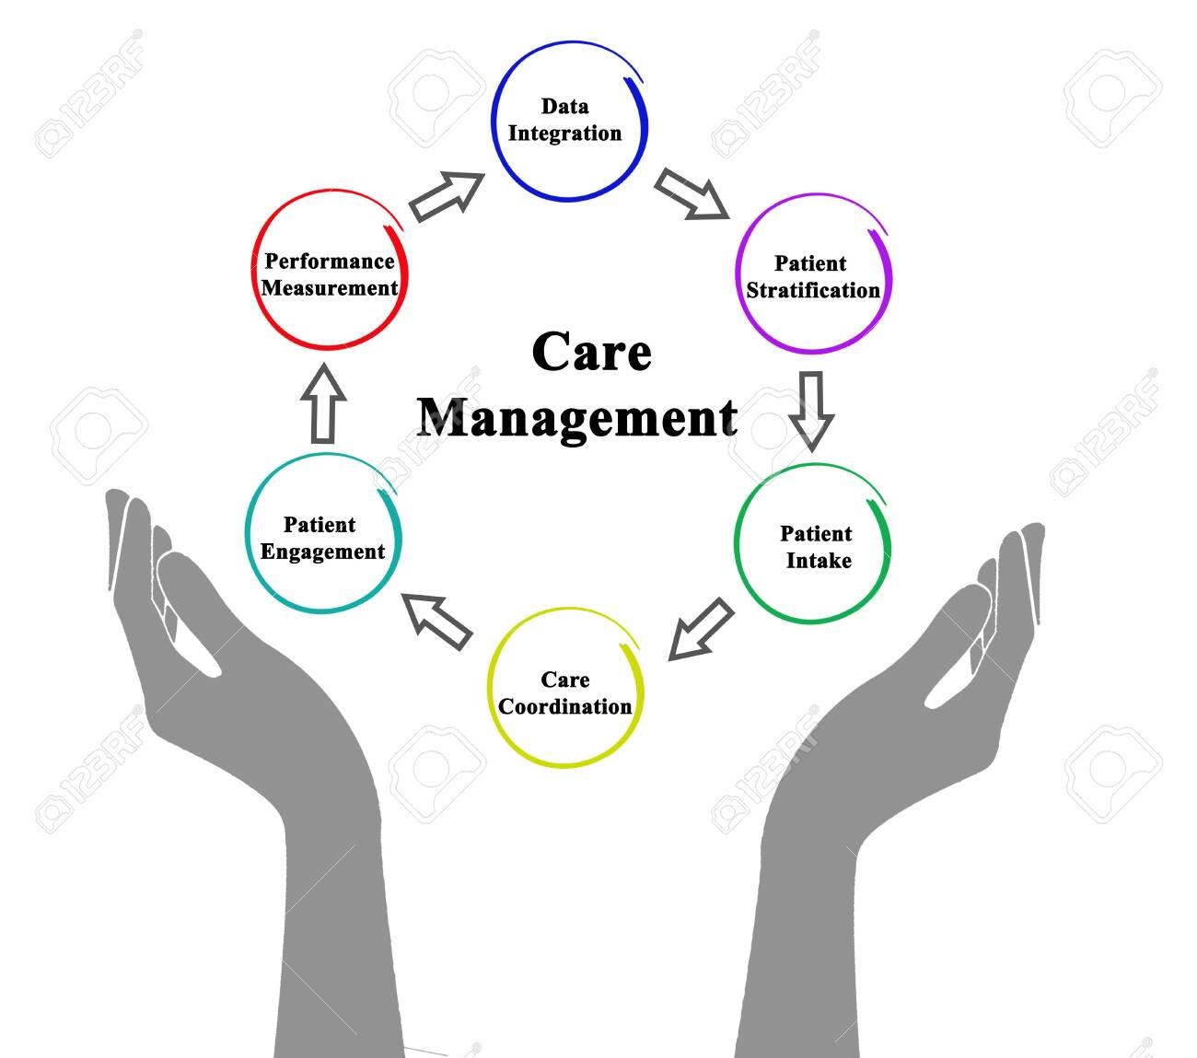
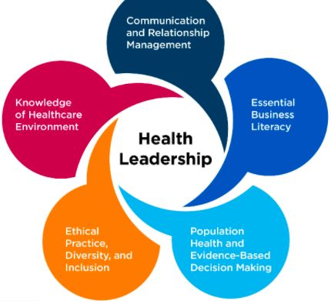
Health Management or Health Leadership?

Slide 21

The role of Health management is diverse

Slide 22

The lens of a health manager

Slide 23
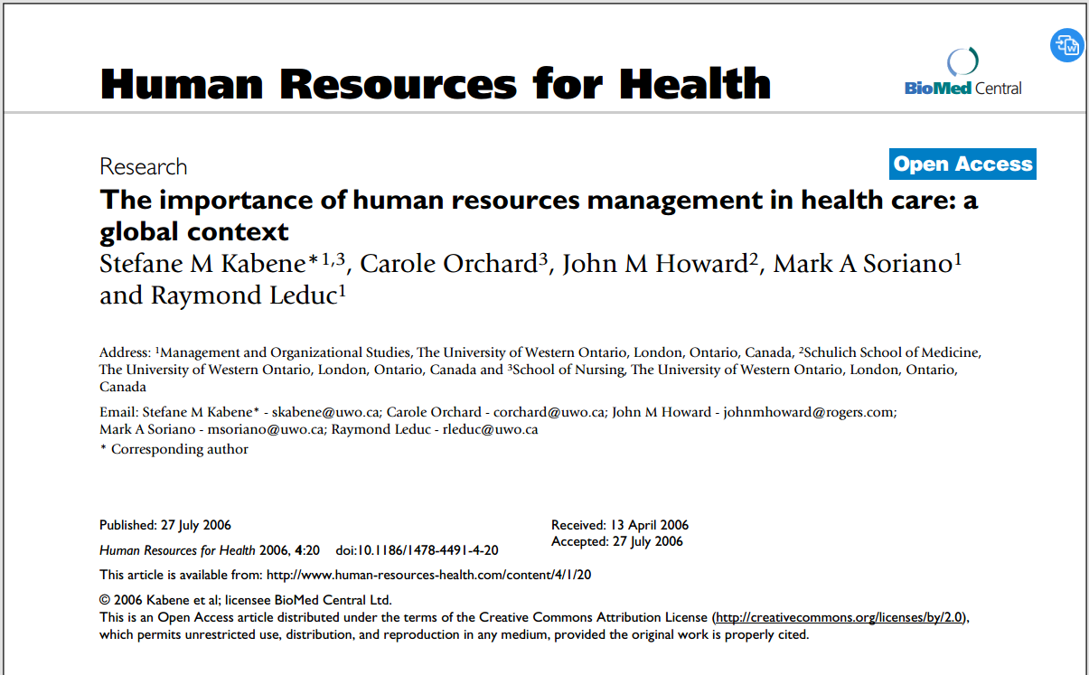
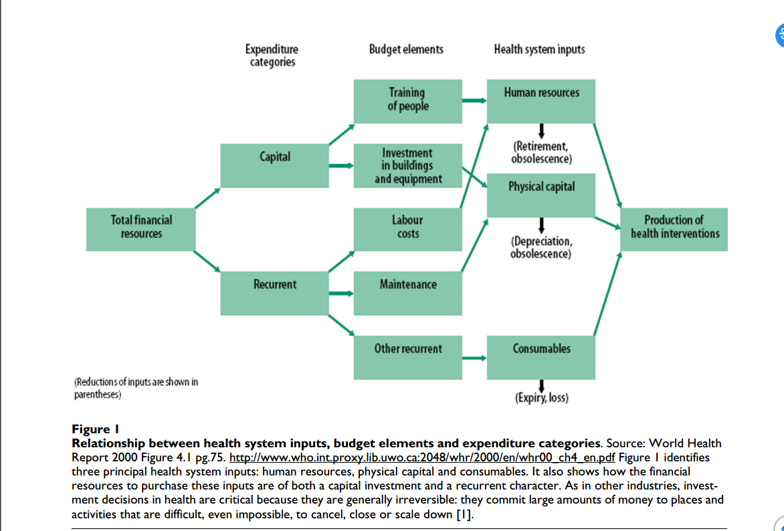

Slide 24
Health management
Healthcare management is the discipline that oversees the planning, coordination, and administration of healthcare services, facilities, and resources.
  It is a crucial part of the healthcare industry, ensuring that medical institutions, clinics, and hospitals operate smoothly and efficiently

Slide 25
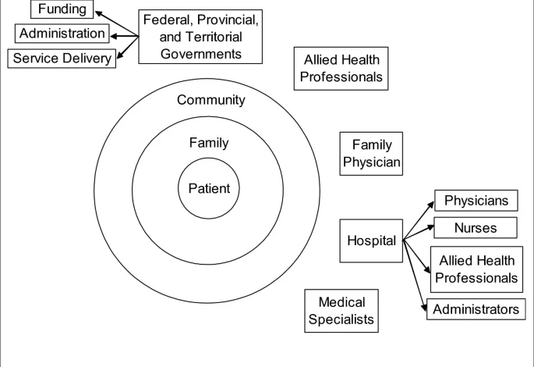
Health management professionals is a coordinator or a leader

Slide 26
Indicators of National Development
Gross Domestic Product (GDP)
Gross National Product (GNP)
GNP per capita
Birth and death rates
The Human Development Index (HDI)
Infant mortality rate
Literacy rate
Life expectancy

Slide 27
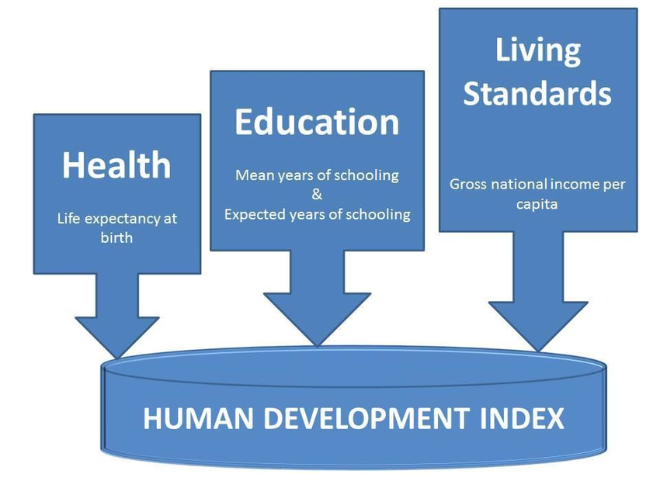
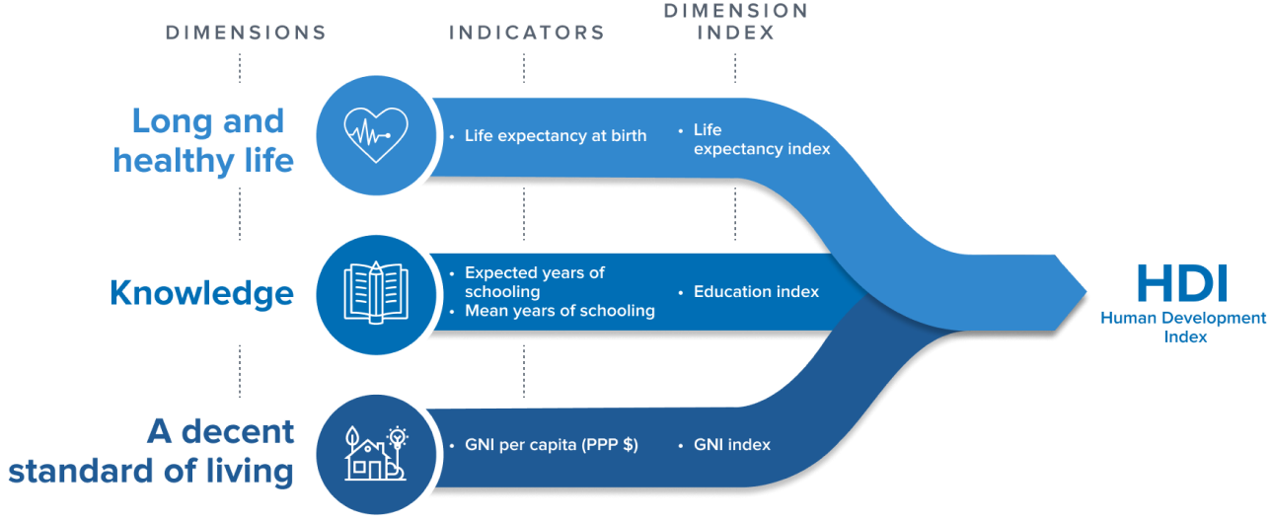

Slide 28
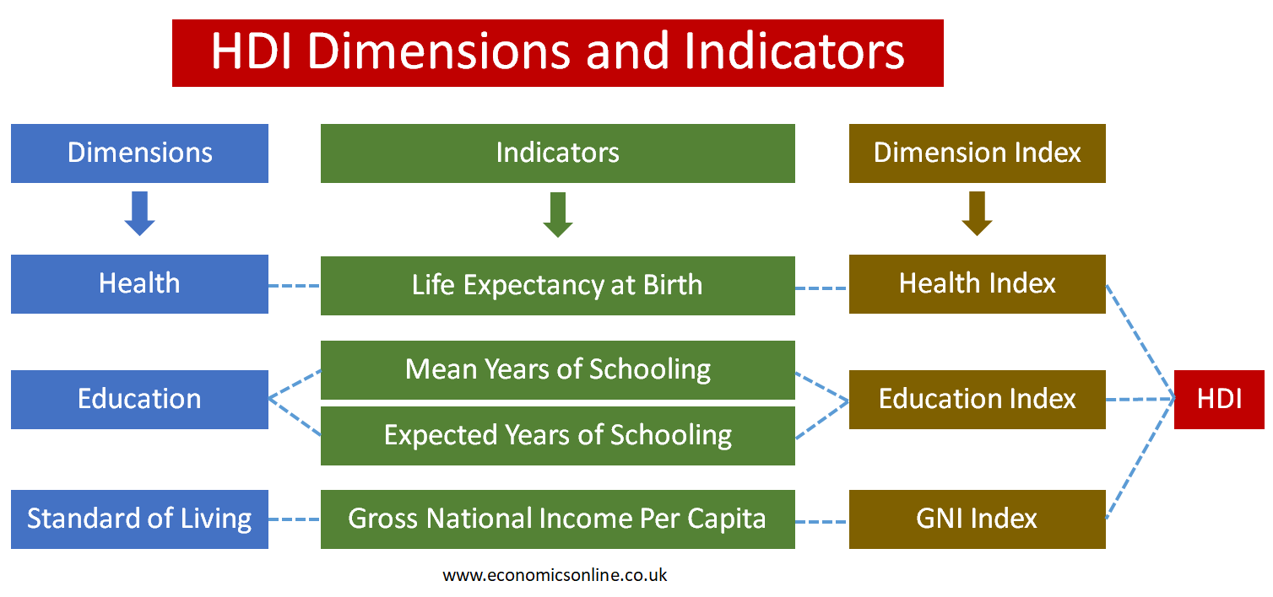

Slide 29
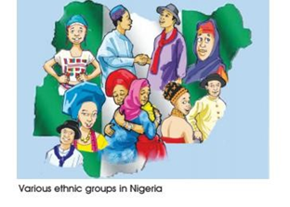
Nigeria – is highly heterogeneous in culture, language, belief and social systems
Huge population
High poverty level
Low literacy level
Below average health outcomes
High infection rates
Considerable natural resources
Conflicts
Unstable polity
Brilliant and hardworking

Slide 30
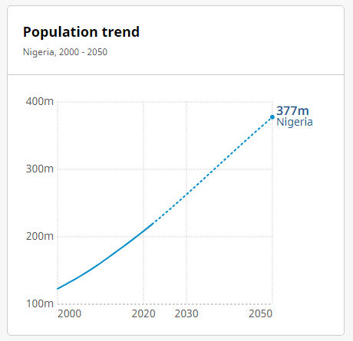
Nigeria as a Case Study
In Nigeria, the current population is 218,541,207 as of 2022 with a projected increase of 73% to 377,459,884 by 2050

Slide 31
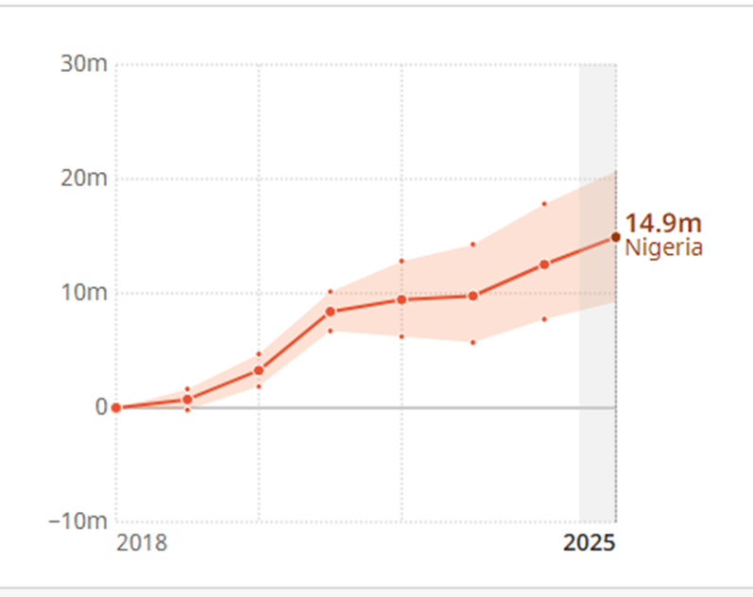
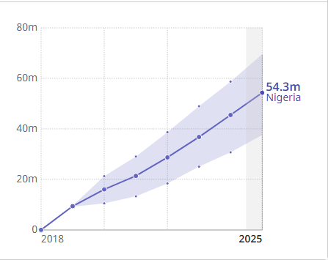
Projected number of additional people expected to be covered by essential health services and not experiencing financial hardship Nigeria, 2018 - 2025
Projected number of additional people expected to be enjoying better health and wellbeing
Nigeria, 2018 - 2025

Slide 32
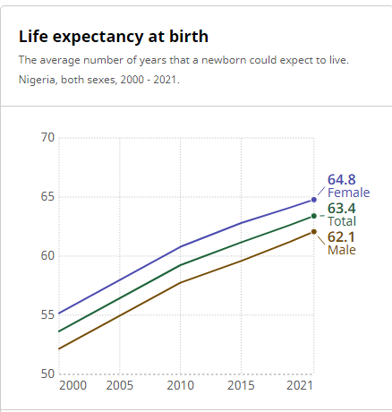

Slide 33
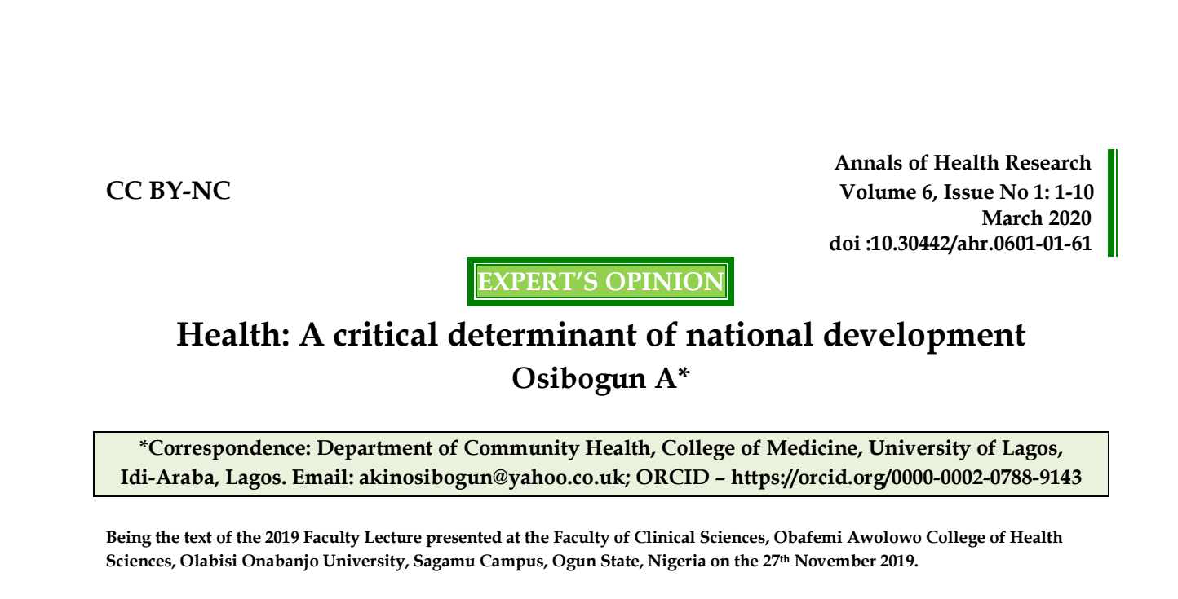
A peep into more indicators of National Development

Slide 34
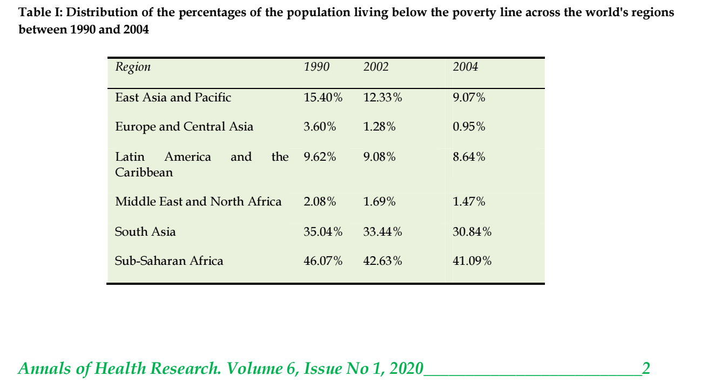

Slide 35
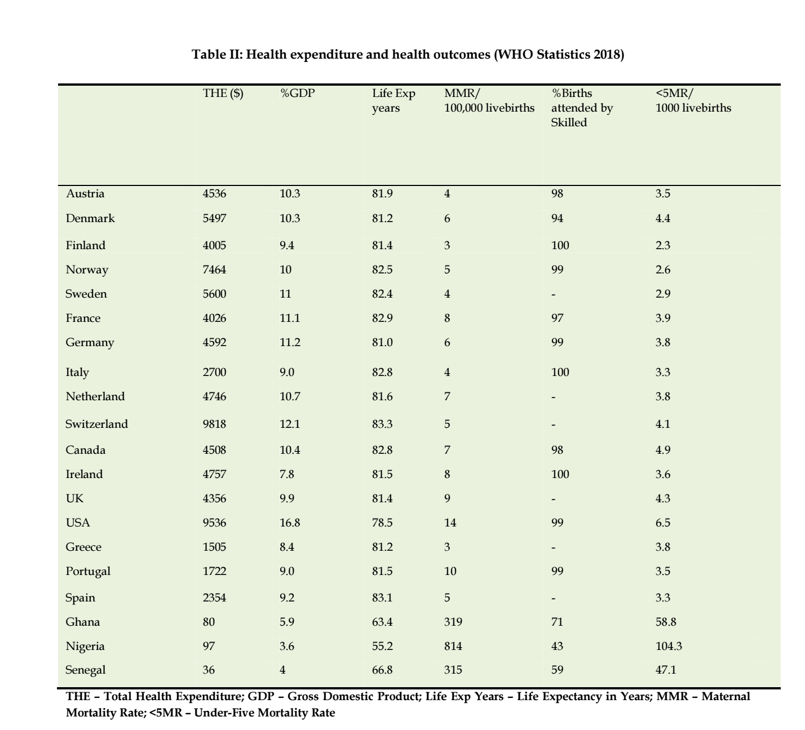

Slide 36
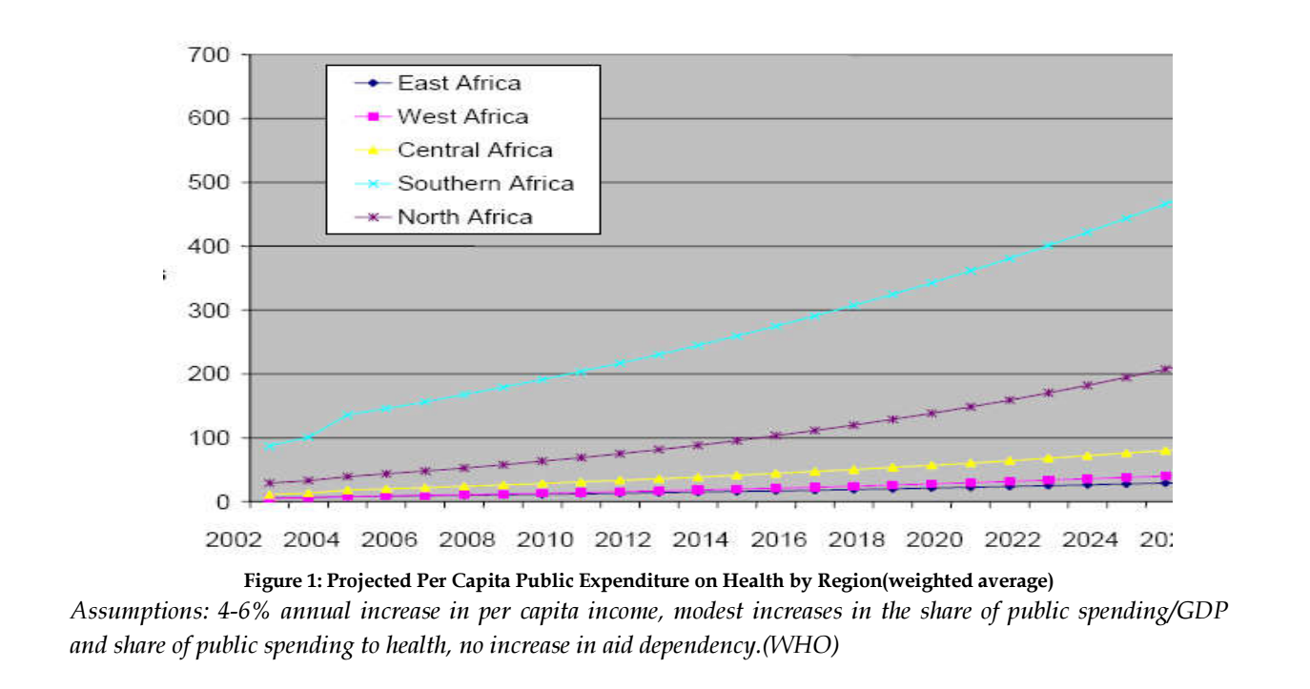
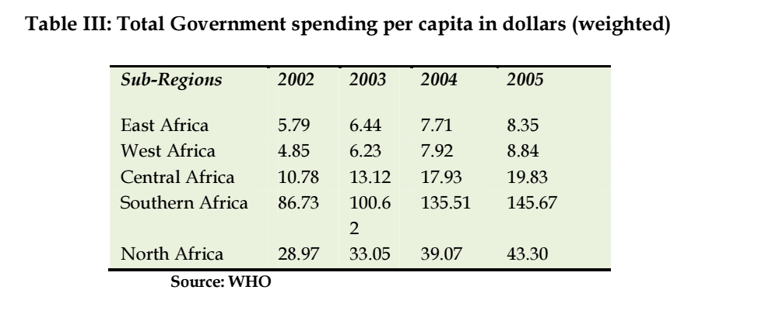

Slide 37
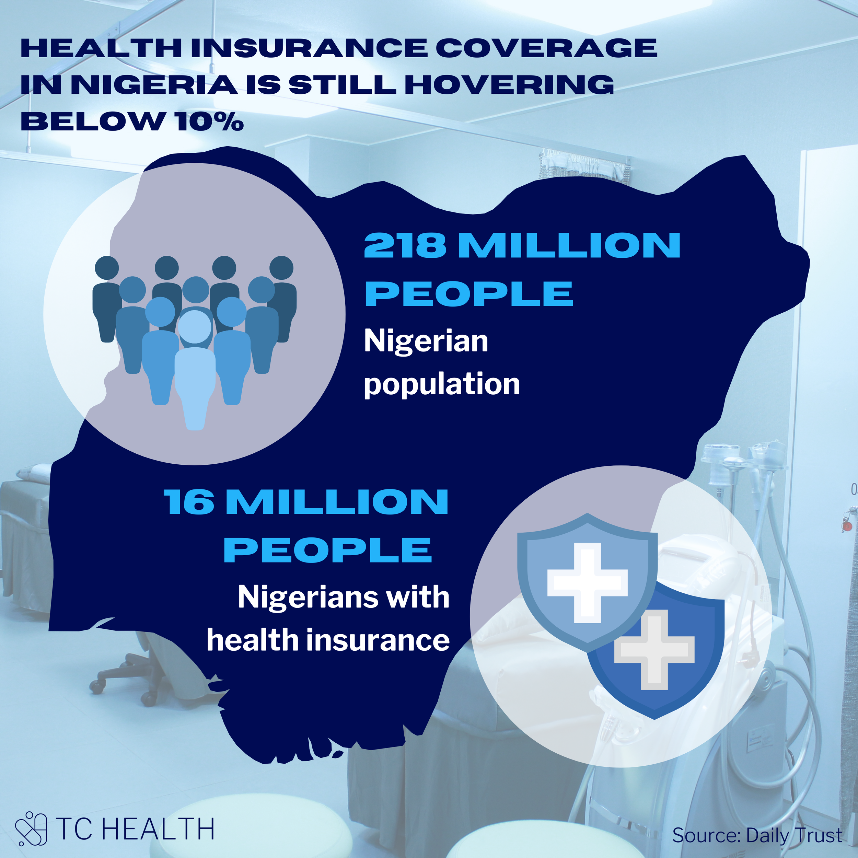

Slide 38
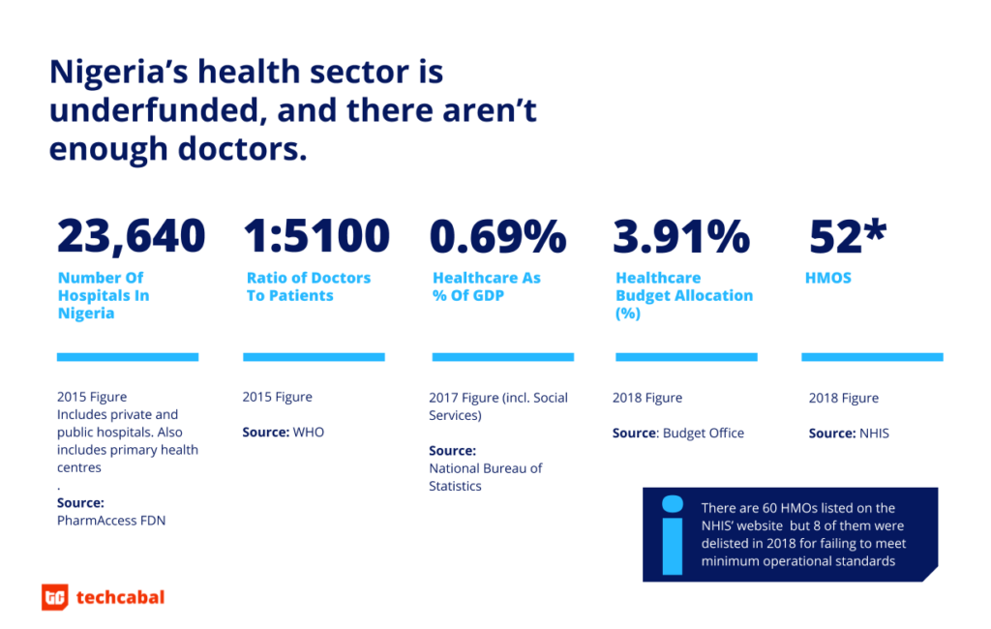

Slide 39
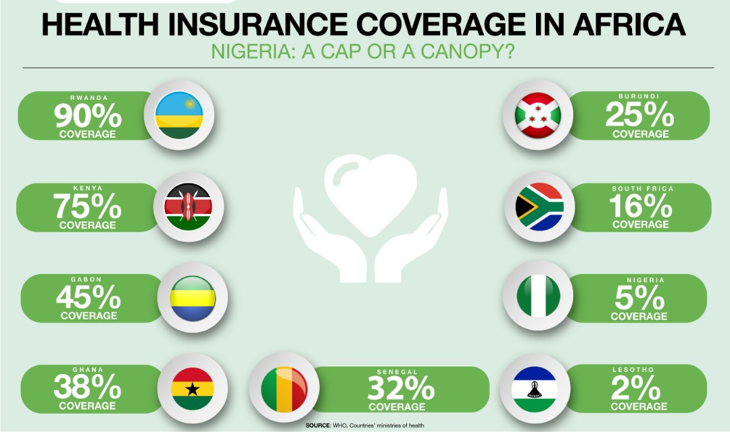

Slide 40

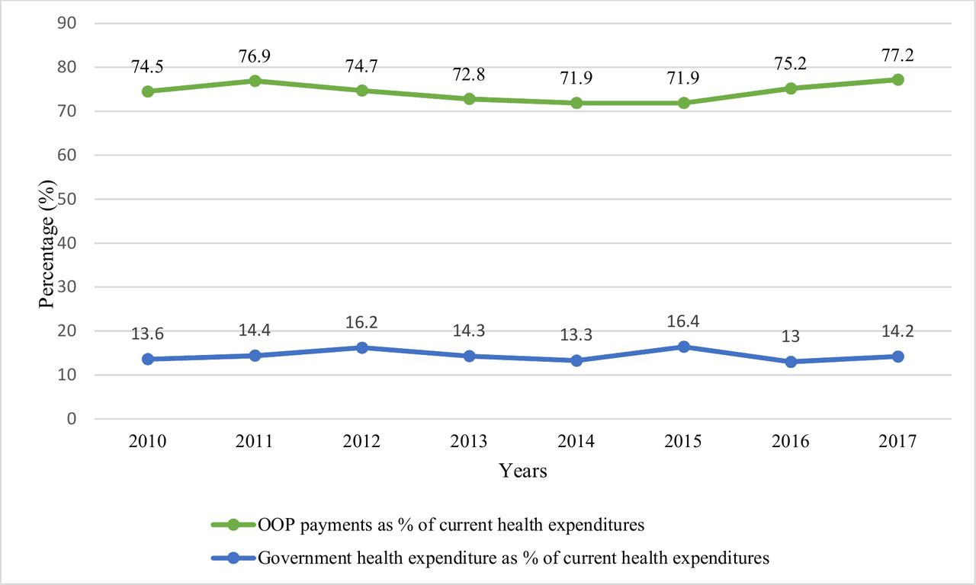

Slide 41
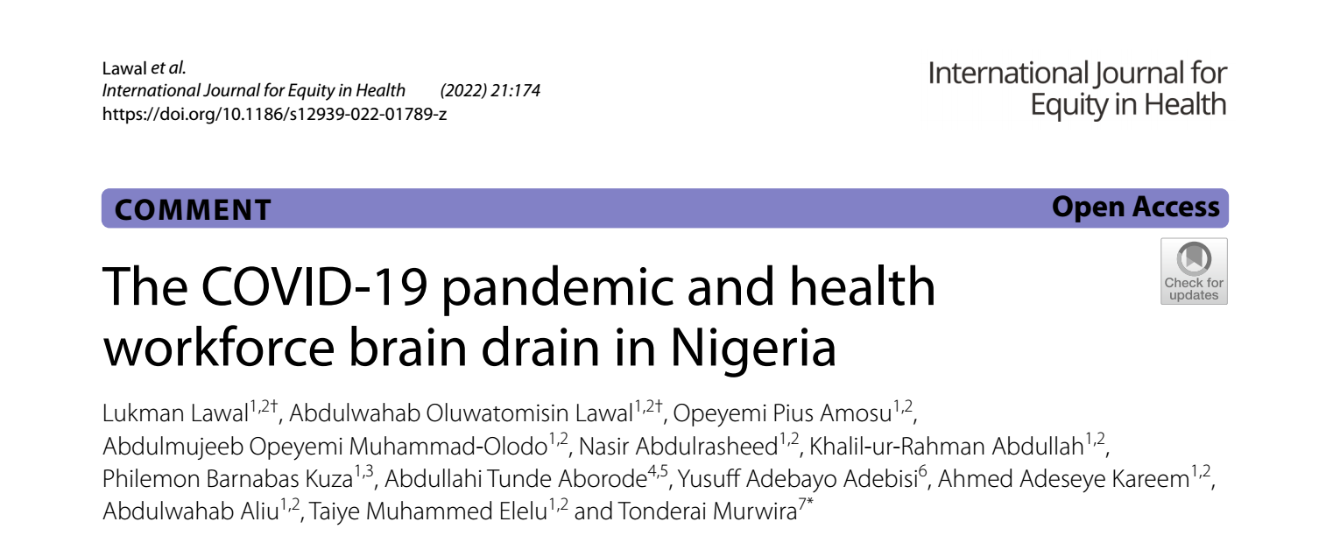
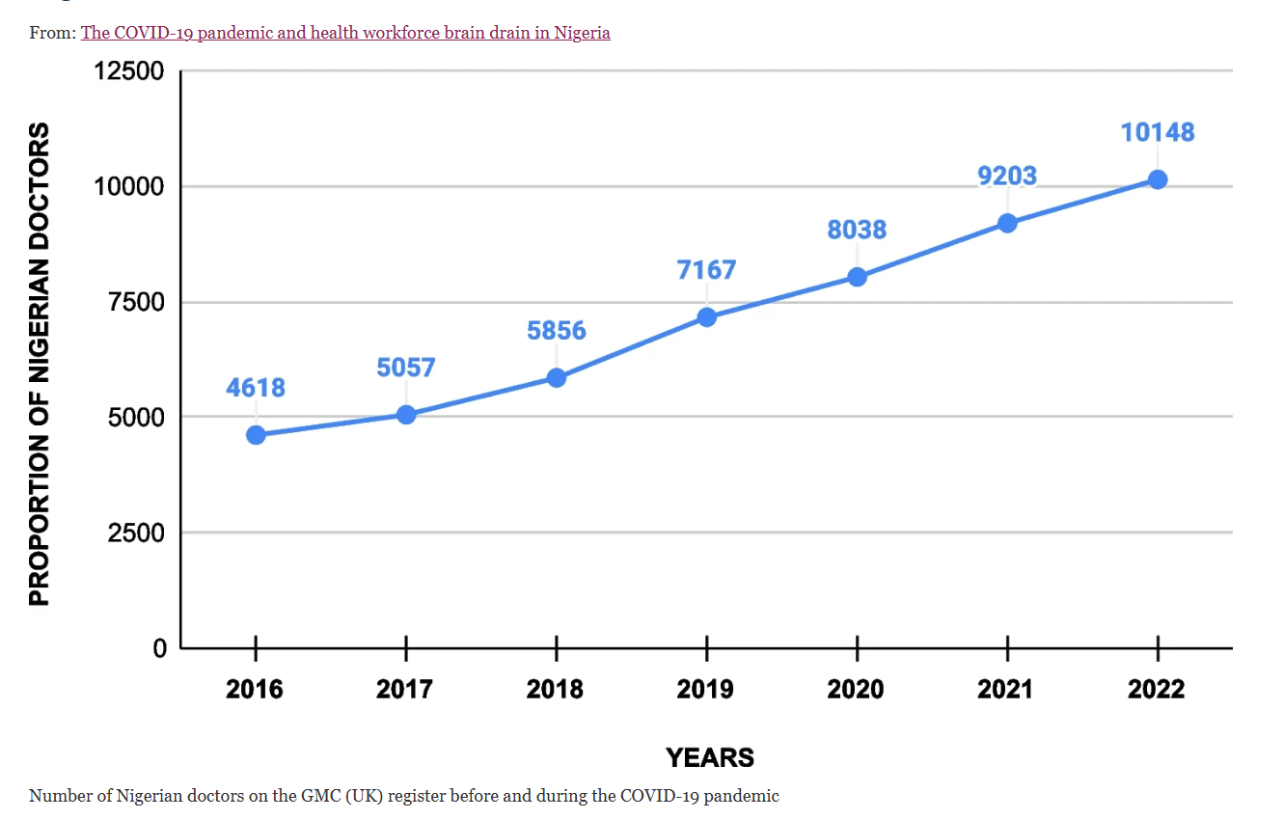
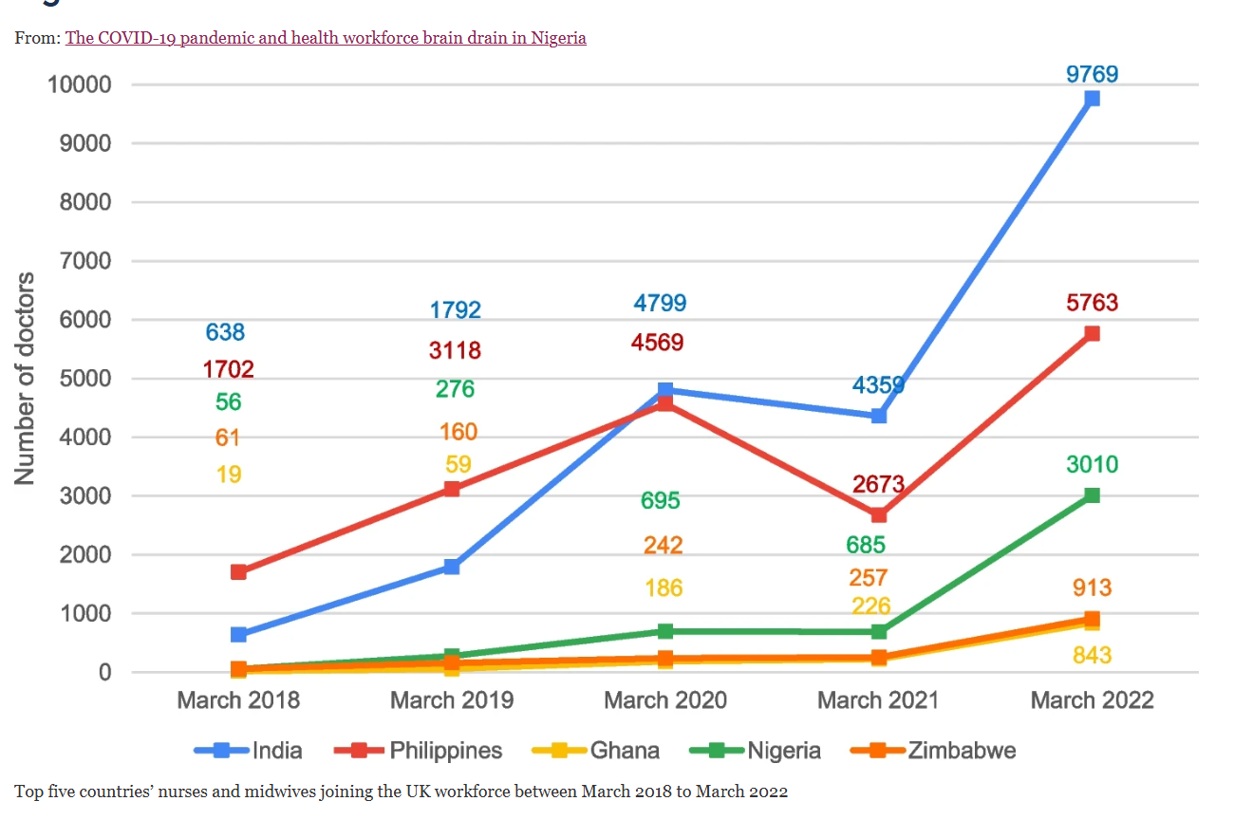

Slide 42
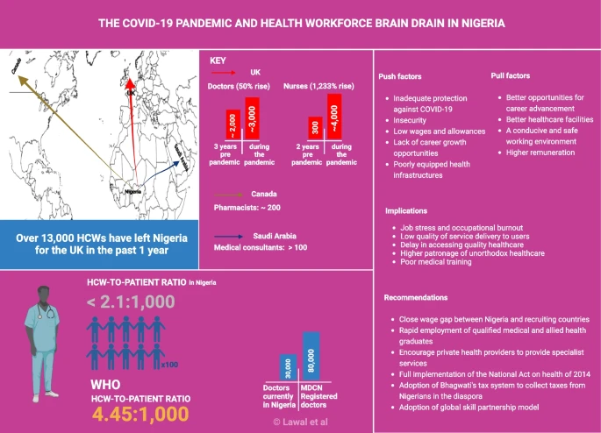

Slide 43
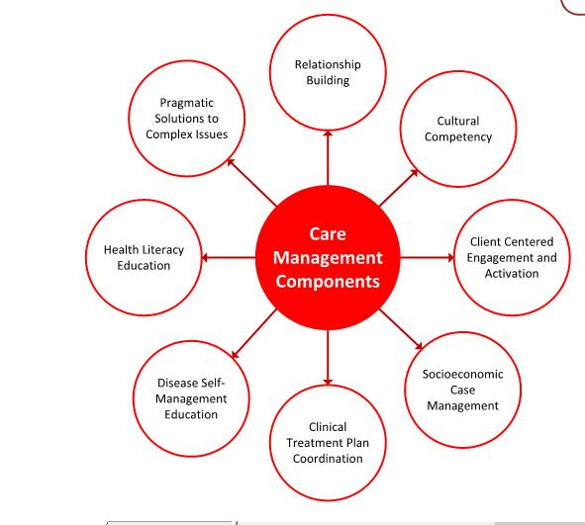
Key components of HCM – an imperative for HMP

Slide 44
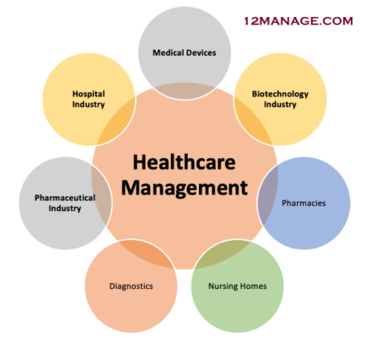

Slide 45
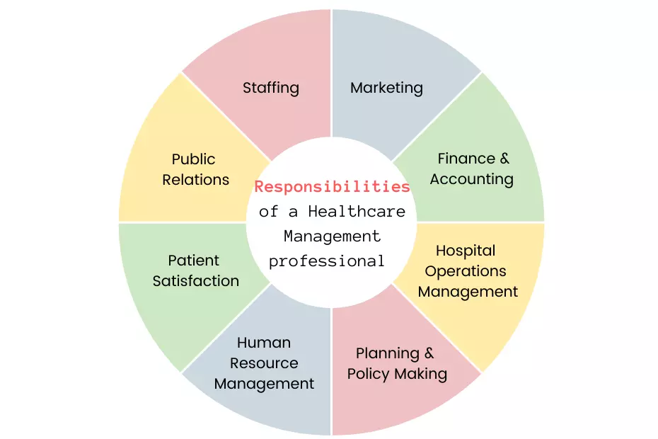
Responsibilities of HMP

Slide 46
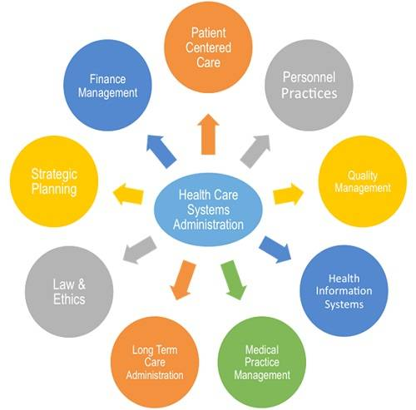

Slide 47
Health system Governance
Health systems governance means ensuring strategic policy frameworks exist and are combined with effective oversight, coalition-building, provision of appropriate regulations and incentives, attention to system design, and accountability.

Slide 48
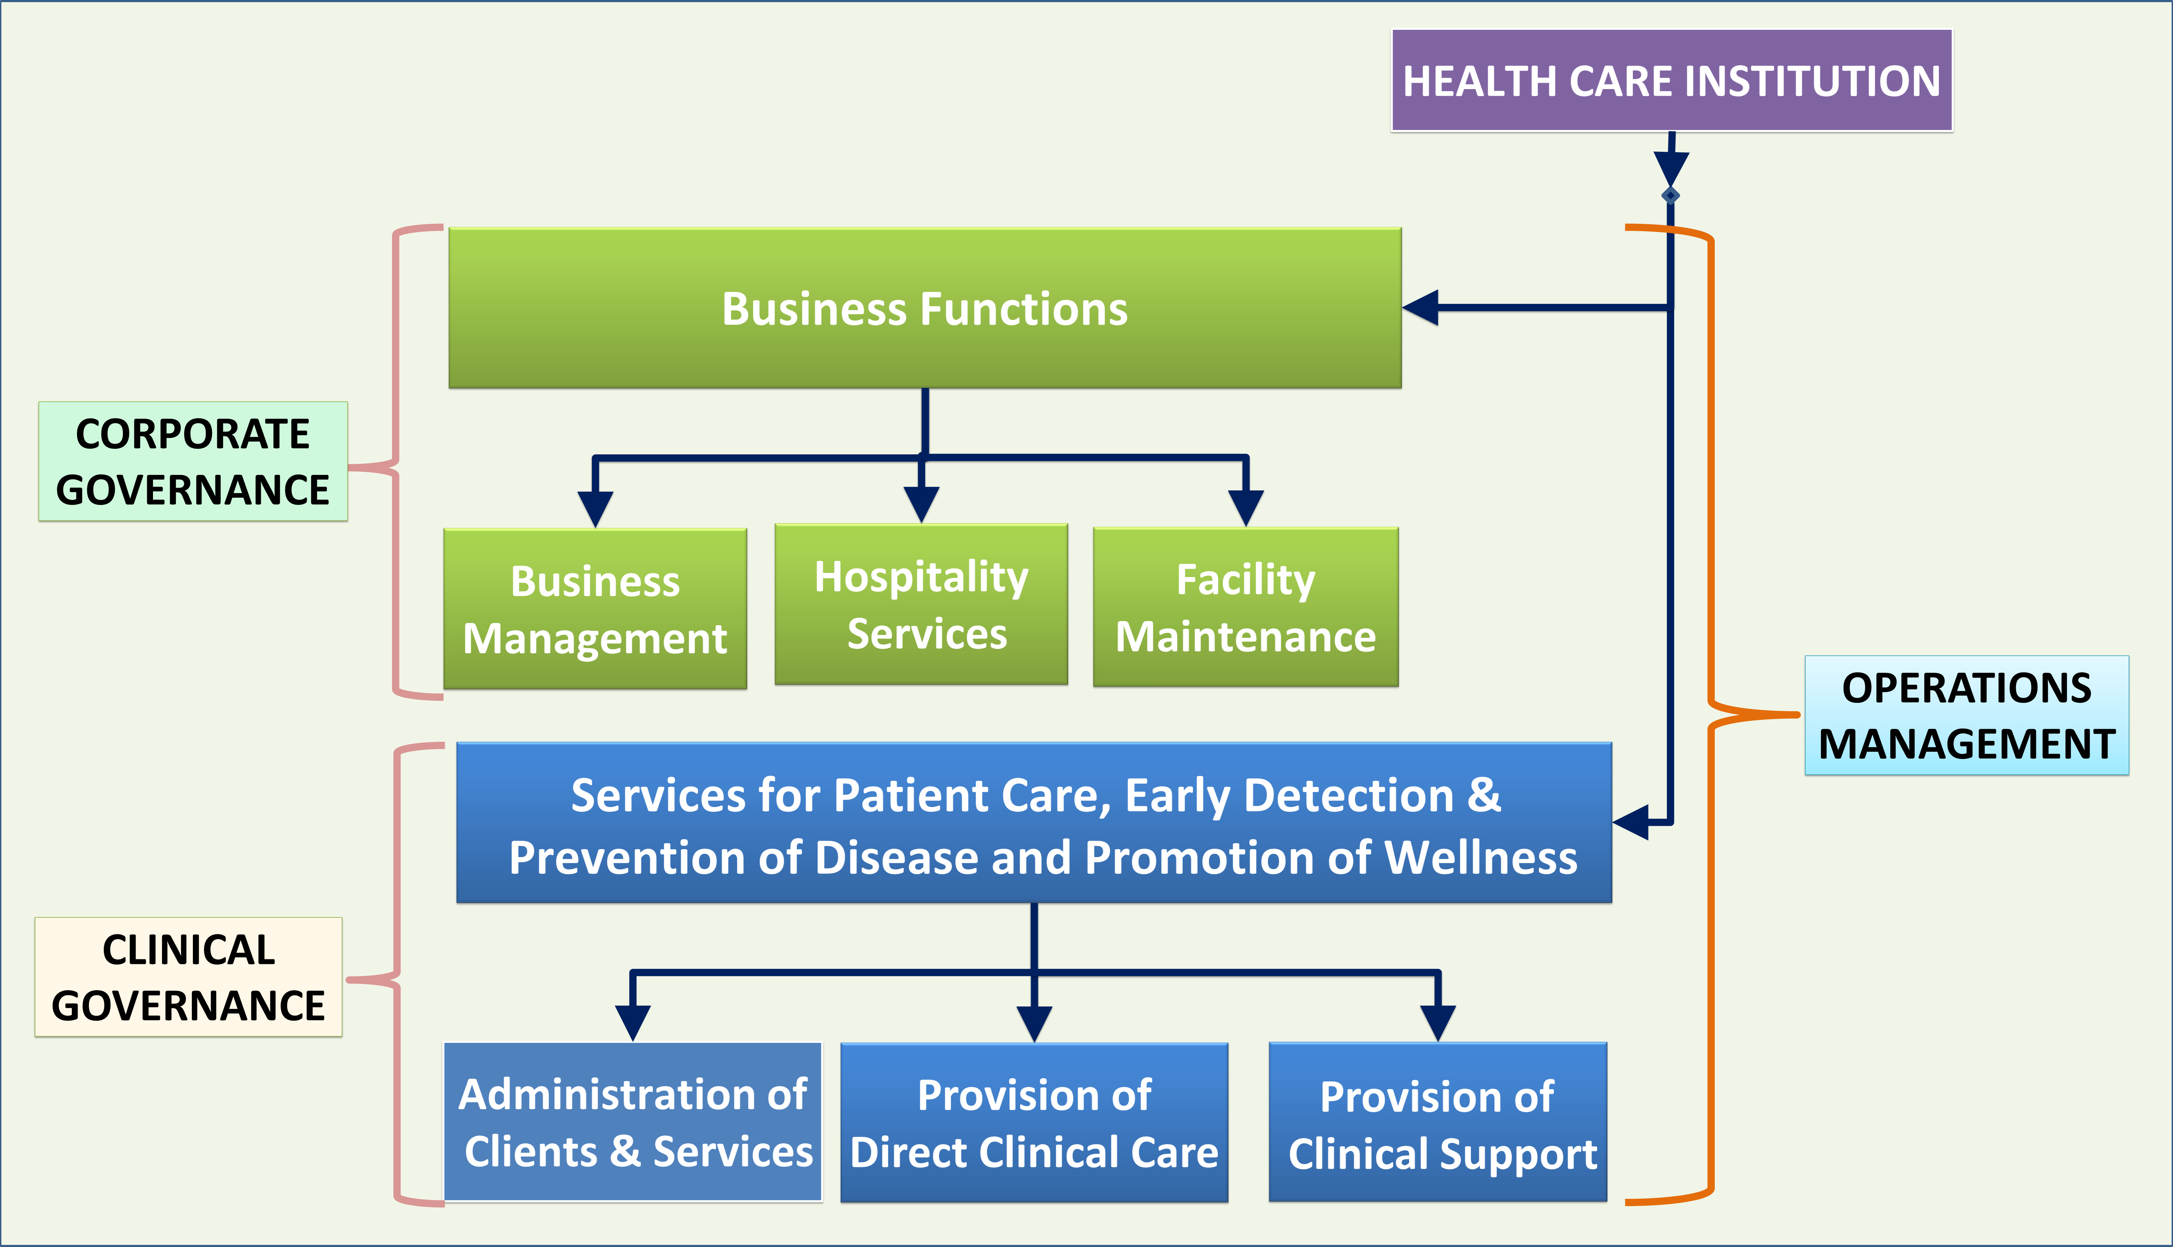
Healthcare as a corporate organization

Slide 49
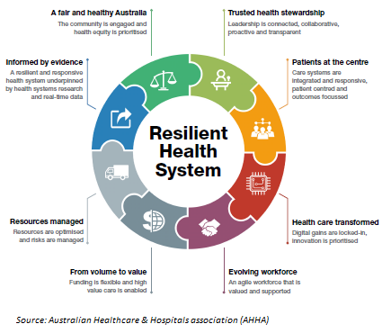
HMP must strive to develop a resilient health system

Slide 50

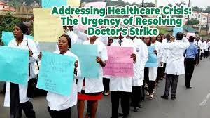


HMP must avoid or never encourage crisis or disharmony in the health sector – always lead to catastrophe

Slide 51

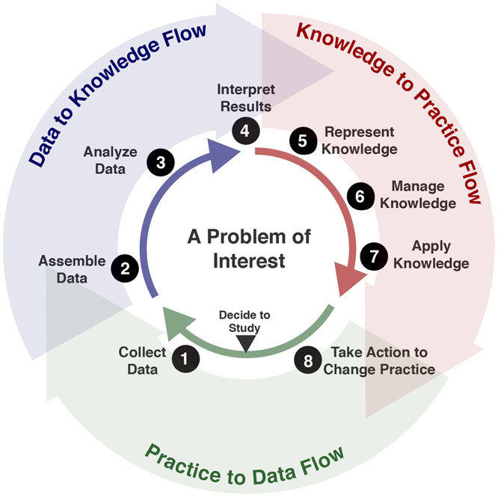
HMP should not work by their name, but should create a learning organization!

Slide 52
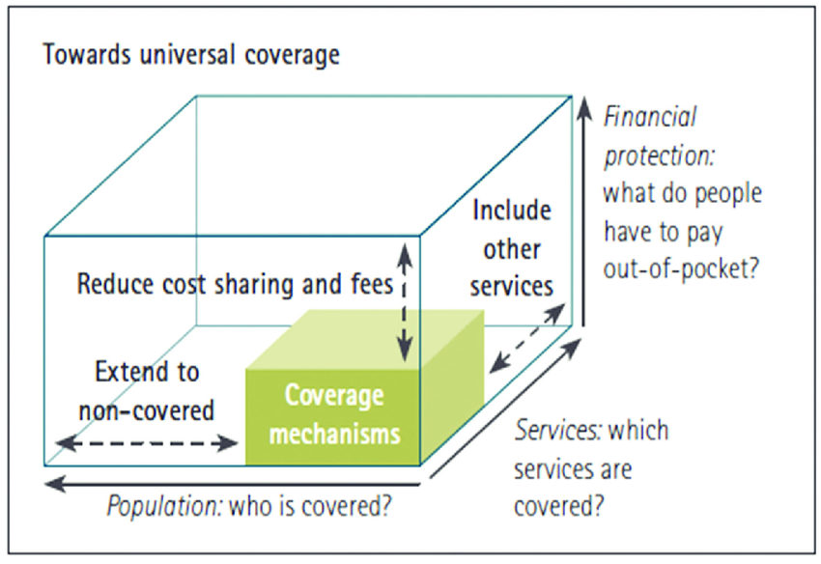
Leave no one behind by ensuring financial risk protection and improve coverage!

Slide 53
Concluding remarks/Take home messages
Health is an important component of National Development – A healthy nation is a wealthy Nation
Health sector leadership is complex and its governance structure is unique
National Development indicators are largely health related
HMP should ensure a learning organization and not promote management culture
Health for all in Nigeria require a strong and efficient professionals that will drive the health sector for a sustainable National Development

Slide 54
Thank you for Listening

Slide 55
