Slide 1
INTELLIGENCE MANAGEMENT AND ITS IMPACT ON SECURITY CHALLENGES IN NIGERIA BEING A PAPER PRESENTED AT THE 2023 CONFERENCE OF INFORMATION MANAGEMENT CONSULTANTS
THEME
‘‘THE FOCUS OF APPLIED INFORMATION MANAGEMENT PROFESSIONALS IN 2023’’
BY
TIM DAKWAT PhD
Rear Admiral (Rtd)

Slide 2
INTRODUCTION
The challenges of insecurity in Nigeria are traceable to lapses in intelligence gathering and proper utilization of same. There are several challenges militating against intelligence gathering among which are unwillingness of the public to share viable information with the security agencies. Lack of citizen’s involvement in state security management and their reluctance in volunteering security information to law enforcement agencies remain part of the lapses in critical security elements application as discussed by Phenson, Ojie, Esin and Atai (2014).
As with other fields of human endeavour, Information Management is equally and currently inundated by the deluge (diffusion/effusion) of information at virtually all levels; this is even complicated by the ever global evolving trends that are ICT driven especially social media and Artificial Intelligence (AI).

Slide 3
INTRODUCTION(Cont’d)
The reality is that world is increasingly globalising, the fault lines of culture depicted by religion, tribe/ethnicity, religion, race, colour etc are rather widening the rhythm, rate, and tempo of human interaction as previously espoused by the late Prof Samuel Philips Huntington in famous exposé ‘‘The Clash of Civilisations and the Remaking of the New World Order.’’ Evidently in the face of these developments there would ensue emergent realities that would challenge virtually every professional including the Information Management Expert; particularly as this seminar determines to examine ‘‘The Role and Focus of the Information Manager in Intelligence Management because of Its Impact on Security Challenges albeit National Security.’’ Consequently this paper will focus on and highlight some conceptual definitions, the Challenges to Security or National Security in Nigeria, the commendable efforts of the FG at tackling them, drawing conclusions before making some recommendations.

Slide 4
CONCEPTUAL CLARIFICATIONS
Intelligence
Impact
Security
Management

Slide 5

CONCEPTUAL CLARIFICATIONS
INTELLIGENCE.
Is the ability to acquire and apply knowledge and skills; the collection of information of military or political value using the Intelligence Cycle. It is the ability to learn or understand or to deal with new or demanding/trying or challenging situations: to apply knowledge in order to positively manipulate one's environment or to think abstractly as measured by objective criteria (as tests) (Dictionary.Com).
Types or levels of Intelligence : Intelligence Quotient (IQ), Emotional Quotient, (EQ), Social Quotient (SQ), Adversity Quotient (AQ).

Slide 6

CONCEPTUAL CLARIFICATIONS
MANAGEMENT
Management is defined as all the activities and tasks undertaken for archiving goals by continuous activities like; planning, organizing, leading and controlling. It (management) is a process of planning, decision making, organizing, leading, motivating, and controlling the human resources, financial, physical, and information resources of an organization to reach its goals efficiently and effectively, in order to maximise or make surplus.

Slide 7

CONCEPTUAL CLARIFICATIONS
IMPACT
Impact. Is the action of one object coming forcibly into contact with another; a marked effect or influence; come into forcible contact with another object, have a strong effect on someone or something. An impinging or striking especially of one body against another, a forceful contact or onset, or the impetus communicated in or as if in such a contact: the force of impression of one thing on another : a significant or major effect.

Slide 8

CONCEPTUAL CLARIFICATIONS
SECURITY
Security. Is the state of being free from danger or threat, the state of being or feeling secure; freedom from fear, anxiety, danger, doubt, etc; state or sense of safety or certainty, something that gives or assures safety, tranquility, certainty, etc, protection; safeguard

Slide 9

CHALLENGES TO SECURITY IN NIGERIA
According to Gbolahan Samuel Moronfolu (2018) the challenges to security, albeit the root causes of insecurity in Nigeria can be ascribed to the lack of institutional capacity and breakdown of institutional infrastructures. The foundations of the institutional framework in Nigeria are very weak, shaky and have provoked deterioration of state governance and democratic accountability, thus, paralyzing the existing set of constraints including the formal and legitimate rules nested in the hierarchy of social order. When these situations exist, the crime rate is bound to rise and the security of lives and properties cannot be guaranteed.

Slide 10
Accordingly the factors that have given rise to insecurity challenges and by implication Intelligence Management in Nigeria include but not limited to the following:
· Pervasive Material Inequalities and Unfairness
· Ethno-Religious Conflicts
· Conflict of Perceptions between the Public and government
· Weak Security System and inability of government to provide adequate weapons to security forces that can match the weapons of dissidents or social miscreants.
a. Loss of Socio-cultural and communal value system
b. Porous Borders
c. Rural/Urban Drift
d. Unemployment/Poverty
e. Terrorism, kidnapping and banditry
f. Cyber crimes
g. Industrial action/protests like the frequent strikes by ASUU, NUT, NMA, and other institutions resulting in workers/students opting to crime and other vices due to idleness, indolence etc

Slide 11
To bolster intelligence management in order to tackle insecurity, a key starting point should be to understand its root causes as well as to investigate the sources of social disorder and instability. Like in many other societies, the sources of insecurity in Nigeria have been traced to a number of factors and explained by different people. These factors have been classified or grouped into external and internal factors. Beyond the external-internal dichotomy, sources of insecurity have also been classified as either remote or proximate and immediate sources/causal factors. In Nigeria, the challenge is not so much about insecurity of external sources. This may not be unconnected with the increasing ethnic hate, religious bigotry, political rivalry and a growing population of disenchanted/disgruntled citizens in the country who feel that they have been short-changed and given very limited or no access to the common patrimony.

Slide 12
The primordial tendencies of various ethnic groups towards violence, the perennial eruption of various ethnic militias and the preponderant religious fundamentalism in place, given expression to by some sections of the dominant religious establishments in Nigeria, have inevitably aggravated the scale and propensity of insecurity and widened its scope in various ramifications.
Additionally, not only has the continued state of insecurity threatened the very fabric of national integration in the country and created the ecology of fear, disquiet and anxiety, it has also meted a deadly blow to industrial development. The destruction of the badly needed infrastructure has taken the country many years backwards. The government has continued to trudge on in the face of this daring challenge and has continued to evolve strategies to contain or douse this conflagration.

Slide 13
The state of insecurity in the country has been sustained by a regressing economy, unviable hospital facilities and health services, lack of good pipe borne water, transportation and bad roads, fuel problems, unemployment and a growing sense of disenchantment that government and its representatives have not been fair to the people, thus pushing some citizens into criminal activities including violent crimes to make a living and to take out their anger on a passive society. Consequently, the state of increased lawlessness, violence and criminality, that has become characteristic of life in Nigeria, has further increased the dismalness of insecurity challenges facing the country.
The diminishing standard of living and the deteriorating social infrastructure like roads, refineries, hospitals and the educational system have all contributed to a nation of desperate people.

Slide 14
Also, religious fundamentalism in the country has arisen as a result of multiple problems including lack of education of the adherents, strongly held misconceptions by religious zealots that the only way to expand their religious territories is by killing those who refuse to be proselytized by their arm-twisting tactics, misinterpretation or literal interpretation of scriptural demands, economic deprivation which forces them to vent their anger on the state and an seemingly insensitive and irresponsible government that has failed consistently to provide the people with the basic necessities of life.
Corruption has remained one of the major drawbacks for national growth and development in Nigeria and the war arrayed against it seems a lost one as more and more public officials and their ilk in the private sector are caught red-handed every now and again in acts of corruption. Honesty, sacrifice, patience, hard work and personal honour, including honourable family values, which were very important cultural values in Africa, have been thrown through the window.

Slide 15
The implication is that the monies that should have been spent on the provision of basic infrastructure and social amenities or used for human resource development purposes or even for equipping the military and other armed forces and paramilitary agencies so they can provide adequate and timely security for the Nigerian people, are “colonized” by a thieving and amoral minority, whose only qualification is access to governance and the national till. The resultant effects of these unethical practices create resource squeeze forcing citizens to compete for the limited employment opportunities in place; social amenities are absent throwing society into despair and anxiety; and politicians continue to recruit unemployed youths and vulnerable citizens, arming them with dangerous weapons to pursue and track down their political foes so as to sustain a climate of repression, fear and cowardice so they can continue in their political offices.
Therefore, the high and sustained rate of violent crimes such as kidnapping, armed banditry, ethno-religious agitation, religious fundamentalism, ethnic pogrom, human sacrifice for money rituals and terrorism that the government continues to grapple with The painful part is that the merchants of violence have continued to wreak havoc on society, without any feeling of moral qualms and have continued to spill the blood of innocent Nigerians.

Slide 16
There is need to regenerate the moral values in the country and even codify them so as to guide the conduct and social relations of Nigerians. These values should be built on the following principles:
1. Every Nigerian deserves to be treated with dignity and rights.
2. No Nigerian should be treated differently because of his ethnic origin, colour, sex, language, religion, political affiliation, property, birth or other status.
3. Every Nigerian deserves to enjoy right to life, liberty and security of person anywhere in the country.
4. Every Nigerian should be saved from undeserved torture and inhuman treatment anywhere in the country.
5. Nigerians should be protected against arbitrary interference with their privacy, family, home, correspondence, honour or reputation.

Slide 17
There is need to regenerate the moral values in the country and even codify them so as to guide the conduct and social relations of Nigerians. These values should be built on the following principles(Cont’d)
6. Every Nigerian is to enjoy freedom of thought and conscience, choice of religion and freedom to teach, practice and worship.
7. Nigerians deserve to enjoy freedom of opinion and expression and right to seek, receive and impart information through any media.
8. Government should be responsible for the welfare of the citizens and should be committed to acts that would eliminate extreme poverty, hunger and deprivation.
9. Moral leadership undergirded by competence and accountability to the people should form the major guiding criteria for the selection of leaders into position of higher responsibility.
10. Nigerians should recognize that they have duties to their community and are subject to laws which respect general welfare and the rights and freedoms of others; and others.

Slide 18
The other solutions likely to solve the issue of insecurity in Nigeria and enhance intelligence management also include leadership development, Good Governance, and Socio-economic Development:
Leadership Development - It is viewed that Nigeria will have to develop visionary leadership, a leadership that is detribalized such that it has at leadership positions only people who are able to inculcate in their people or followers, the idea of common citizenship as the transcendent factor among all Nigerians, no matter the tribe, gender, religion, economic and social status.
In other words, it is imperative that we have leaders who would not be limited to championing the causes of their home state, tribe, or religious groups, but rather focused on deeds and pronouncements which convincingly and positively impact the entire citizenry of the federal republic” of Nigeria. The argument for this is that such leaders “will help to mould the contending ethnic and religious groups into harmony and help to remove the perceived mutual distrust among them. The process of developing visionary leadership can be challenging, however, it can be overcome “by using institutions as a nursery ground to produce leaders with national outlook and with a missionary zeal to transform the nation.” The re-establishment of the Citizenship and Leadership Training Center (Man o War Bay), the Cadet Corps in Secondary Schools would significantly enable this idea.

Slide 19
Good Governance – Good governance is the panacea to the security challenges in Nigeria. The war against insecurity would be won only by raising governance standards; that is, cultivating the culture of good governance where the government is responsible and accountable to the people. Security engagement cannot be separated from good governance. Many others have also linked security to the governance system. The general view is that peace and security are determined by good governance. However, good governance is a function of effective, visionary, transparent, trustworthy, and credible political leadership whose driving force is an improvement in the collective wellbeing of the citizens through well-conceived, effectively implemented economic policies and human development programs. The underlying principle of good governance is the focus on people as the ultimate objective of governance.
The Socio-Economic Development - This factor is strongly considered as the major key to peace and security in Nigeria. The challenge in solving the insecurity problem in Nigeria is to accelerate the pace of development. Development in this context consists of creating an economy with relevant social, economic, and physical infrastructure for businesas operations and industrial growth, to provide gainful employment, high-level education facilities, and medical care for the people.

Slide 20
THE NIGERIAN EXPERIENCE
Efforts of the Federal Government in Tackling Insecurity
The war against insurgency in Nigeria is increasingly getting more complex and complicated. In response to this the FG has promulgated far reaching policy initiatives to combat the current security challenges, and these include the following:
a. National Crisis Management Doctrine: In the bid to unify the approach to fight against terrorism the President recently launched the National Crisis Management Doctrine (NCMD), that essentially is a revision of the National Counter Terrorism Strategy 2016 (NACTEST 2016); The NCMD is designed to bridge the gap created by extensive deployment of security forces by fostering effective and efficient collaboration with MDAs through five (5) workstreams namely; Forestall, Secure, Identify, Prepare and Implement.

Slide 21
b. The Police Act 2020: Contingent to other laudable initiatives of the FG, is the promulgation of The New Police Act which brought in some radical changes in the operations of the Nigerian Police force and how they relate with the citizenry, with particular focus on effective policing, accountability and transparency, protection of human rights and freedom in accordance with the provisions of Chapter 4 of the Constitution, the African Charter on Human and Peoples’ Rights and the Universal Declarations on Human Rights. The new Police Act prohibits the Police from arresting anyone based on a civil wrong or breach of contract and also prohibits the arrest of any person by proxy. It is actually an offence for a Police Officer to arrest any person in place of a suspect.

Slide 22
It is however instructive to note that terrorists/insurgents are ultimately in competition over information rather than territory and/or ideology (Meserole, 2018). However, the deployment of technology AI in the fight against the menace of insurgency, kidnapping and armed herdsmen in Nigeria could be of strategic importance in winning the war. AI technology could, for example, facilitate autonomous operations, lead to more informed military decision making, and increase the speed and scale of military action (CRS Report, 2020).

Slide 23
The reason for this is attributed to the following:
1. While the drivers of insecurity still remain unknown; drugs/narcotics, small arms and light weapons, separatists agitations and poor national data base remain the levers of insecurity particularly terrorism and insurgency.
2. Our forests, remote locations (ungoverned spaces) including uncompleted buildings have become sanctuaries, safe havens, nukes/nestling points for insurgents and criminal gangs.
3. Abundant endowment of Nigeria in natural/human resources vis a vis intense economic interests by foreign investors (both genuine and rogue elements).
4. Need to protect critical infrastructure.
5. Need for intercepts on intentions of insurgents and geolocation of their position including movement.
6. Need to synergise and balance both kinetic and non-kinetic operations against terrorism and insurgency.

Slide 24
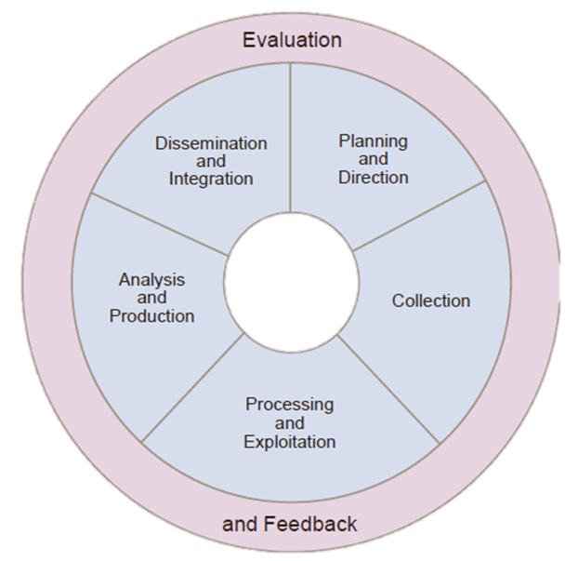
The Process of Intelligence Management (Intelligence Cycle)
Looking specifically at the security intelligence or intelligence gathering or intelligence management cycle which according to (Lowenthal 2002) is the process by which specific types of information relevant to national security is requested, collected, analysed, and provided to policy makers; the products of that process; the safeguarding of these processes and information by counterintelligence activities; and the carrying out of operations as requested by lawful authorities. Before any law enforcement agency can begin to respond to criminal or security threats, it must first understand them.

Slide 25
Law enforcement agencies are expected to understand and effectively operate in a complex social, political and organizational environment (Casey and Mitchell, 2007). Murray (2000) argued further that it is essential for law enforcement agencies to have an understanding of current environment to develop strategies and plans to meet the identified challenges.
This can only be achieved through gathering of intelligence. Capacity must be built to collect, collate, analysed and disseminate information on criminal activities and various security challenges so as to afford the necessary law enforcement agents to operate effectively in combating such challenges.

Slide 26
Intelligence is managed through the time tested Intelligence Cycle, which essentially is the process of tasking, collecting, processing, analysing, evaluating, and disseminating intelligence. The cycle involves developing unrefined data into polished intelligence for the use of policymakers. The cycles consists of six steps:
a. Tasking/Requirements (Needs Assessment)
b. Planning & Direction
c. Collection
d. Processing; Analysis & Production
e. Dissemination
f. Feedback.

Slide 27
CHALLENGES OF INTELLIGENT MANAGEMENT IN NIGERIA
The trends in intelligence management have been evolving and changing, because there are often new strategic threats, actors, challenges, and trends in crime and criminality; hence intelligence itself must be dynamic albeit adaptive. To analyse the current international security environment more efficiently, it is essential to explore these current challenges and trends (in intelligence) since they determine the national security settings of countries.
Accordingly the current challenges in intelligence could be categorised into four groups namely: technological, financial, organizational, and political. More specifically, it is argued that the increasing use of meta-data, social media and cybersecurity are current technological challenges in intelligence. Likewise, the increasing use of virtual currencies is a financial challenge in intelligence, while increasing competition with the private sector is an organizational challenge. Lastly, increasing nationalism and anarchism, ISIS returnees, and expansion of hybrid/asymmetric warfare are political challenges in intelligence. It is important to note that the impact of these challenges may vary from country to country, hence these challenges pose a threat to all of a country’s official intelligence structures to some degree regardless of the level of development of that country.

Slide 28

CONCLUSION
Nigeria is currently grappling with a lot of security challenges notably insurgency, terrorism, unemployment, poverty, movements for self-determination; the efforts of the Federal and State Governments in tackling these challenges have significantly arrested the excesses of insurgent and terrorists including other forms of criminality. The promulgation of the NCMD and Police Act are commendable efforts that have redefined and enhanced the management of intelligence; notwithstanding more needs to be done to further positively impact security challenges and this demands a Comprehensive albeit Whole of Government Approach, with technology driven approaches that employs the use of drones, CCTV, AI, machine learning, forensic laboratory, etc.

Slide 29
CONCLUSION (Cont’d)
Such laudable initiative is further anchored on credible citizen resilience that draws on the active and efficient participation of youth groups like the Boys Scout, Girls Guide, Brownie, Boys/Girls Brigades, Red Cross and Red Crescent Societies. The promulgation of appropriate initiatives and emplacement of all the measures to counter security threats would fall short of expectations if appropriate legislations are not enacted to deter would be criminals.

Slide 30

RECOMMENDATIONS
Arising from the foregoing, it is recommended that the Federal and State Governments:
a. The ministries of Information and Interior in collaboration with the National Orientation Agency and embark and sustain the campaign on nationalism/national consciousness and patriotism.
b. Sustain the education, sensitisation, and mobilisation of law enforcement agencies on the demands of the recently promulgated NCMD, Police Act, National Security/Defence Policies.

Slide 31
RECOMMENDATIONS(Cont’d)
c. Enhance citizen resilience by reviving the citizenship/leadership development centers (Man o War Bay) throughout the country.
d. Revive the moribund Boys Scout, Girls Guide, Brownie, Boys/Girls Brigades, Red Cross/Red Crescent organisations and give them prominence in order to bolster community policing efforts.
e. Establish Special Weapons and Tactics Teams (SWATs) starting from all urban centers throughout the country.

Slide 32
RECOMMENDATIONS(Cont’d)
f. Expand, extend, deepen, and sustain border patrols in all frontiers of the country.
g. Embrace and promote use of technology: drones, Artificial Intelligence, Machine Learning, Forensic Laboratories, CCTVs, speed and safety cameras etc.
h. Enact a more robust legislation against terrorism/insurgency in order to deter would be criminals.

Slide 33
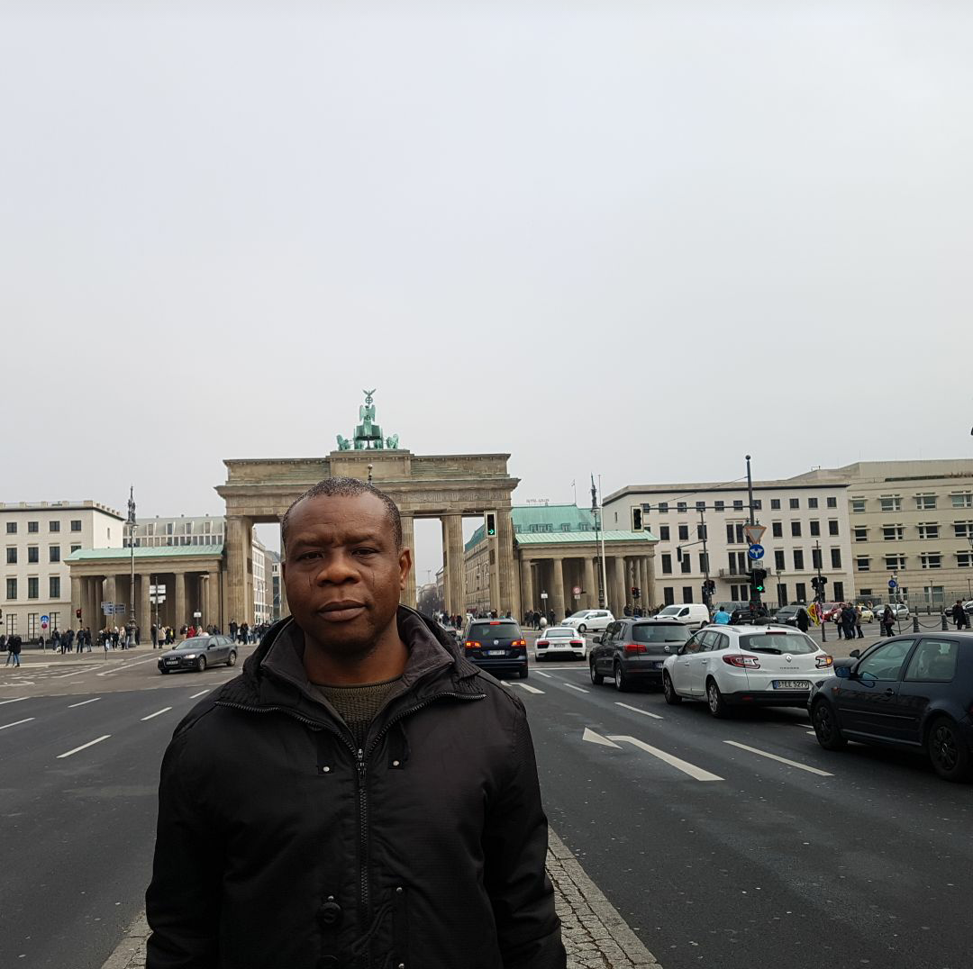
Thanks!
Any questions?
You can find me at:
timothydakwat@gmail.com

Slide 34
Challenges of Intelligent Management in Nigeria
The trends in intelligence management have been evolving and changing, because there are often new strategic threats, actors, challenges, and trends in crime and criminality; hence intelligence itself must be dynamic albeit adaptive
To analyse the current international security environment more efficiently, it is essential to explore these current challenges and trends since they determine the national security settings of countries
Accordingly the current challenges in intelligence could be categorised into four groups namely: technological, financial, organizational, and political

Slide 35
CONCLUSION
Nigeria is currently grappling with a lot of security challenges notably insurgency, terrorism, unemployment, poverty, movements for self-determination; the efforts of the Federal and State Governments in tackling these challenges have significantly arrested the excesses of insurgent and terrorists including other forms of criminality
The promulgation of the NCMD and Police Act are commendable efforts that have redefined and enhanced the management of intelligence; notwithstanding more needs to be done to further positively impact security challenges and this demands a Comprehensive albeit Whole of Government Approach, with technology driven approaches that employs the use of drones, CCTV, AI, machine learning, forensic laboratory, etc

Slide 36

9. Prosecution by a Police Officer
What has been improved?

