Slide 1
16th Logistics Seminar
Applied Information Technology : An Inevitable tool in Marketing & Communication Media
Stephen Ogu Okpanachi Moses
Organized by
Association of Applied Information Management Professionals
Ayalla Hotel , Garki Abuja, 13th May 2023

Slide 2
Presentation Outline
Definition of terms/Introduction
Contributions of Applied Information Technology to Communications Media
Challenges of Information Technology in Communication Media
The Way Forward

Slide 3
Definition of Terms
Information Technology
as the infrastructure and components that enable modern computing.
manipulates and store data through electronic processes.

Slide 5
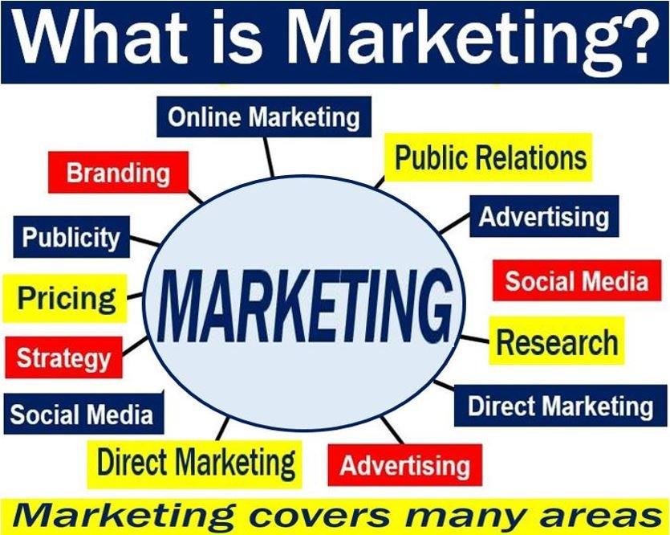

Slide 7
Introduction
The IT structure is an integral part of our lives
The smart phone now is the convergence point between broadcasting and telecommunication
IT had reduced the importance of distance(Covid 19).
Removal of intermediaries would reduce the costs.

Slide 9
COVID -19

Slide 11
5G To Transform Lives

Slide 12
Contributions of Applied Information Technology to Communications Media
Technological development
DSNG/TVU Pack/Live View
Unmanned Studio/TX Operations
Skype /Zoom Tech
Citizen Journalism
Advertising through the internet
Interactive media
Easier for the media companies to connect with relevant people with the speed of space rocket.

Slide 13
Challenges of Information Technology in Communication Media
The spread of Fake News.
Telecommunication monopolies in the rural areas.
IT boost growth in developed economics, but in Nigeria the opposite.
IT access to all a problem.
Lack of IT infrastructure.
Social Media negatively affects our children.

Slide 14
The Way Forward
AiMP to establish a study group that would carry out an empirical study on all the associated challenges of IT in communication media.
Government to build the necessary physical infrastructure for ICTs.
Government has to play the role of catalyst and regulator.

Slide 15
The Way Forward
Provide access opportunities, tools and content particularly suited to the priority needs of women & handicapped.
Regular conferences, seminars and workshop should be held to create awareness.
The PPP policy of Build Operate & Transfer to be implemented for IT Infrastructure in rural areas

Slide 16


Conclusion
I therefore state that Applied Information Technology is an inevitable tool in Marketing and Communication Media

