Slide 1
Information Communication Technology (ICT) application as a tools for Repositioning of Academic Libraries for Effective and Efficiency in Nigerian Universites
By
Sahabi, M. K.
&
Unobe, Elameyi Susan
Being a Paper to be delivered at National Conference on Applied Information Management Technology (AIMT), Babcock University between 16rd -18th of MAY, 202
1

Slide 2
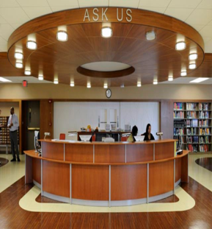
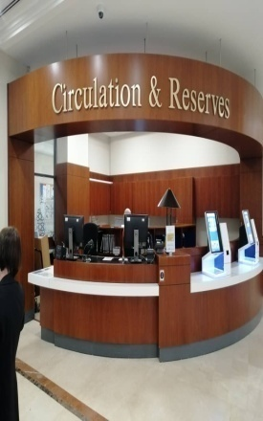
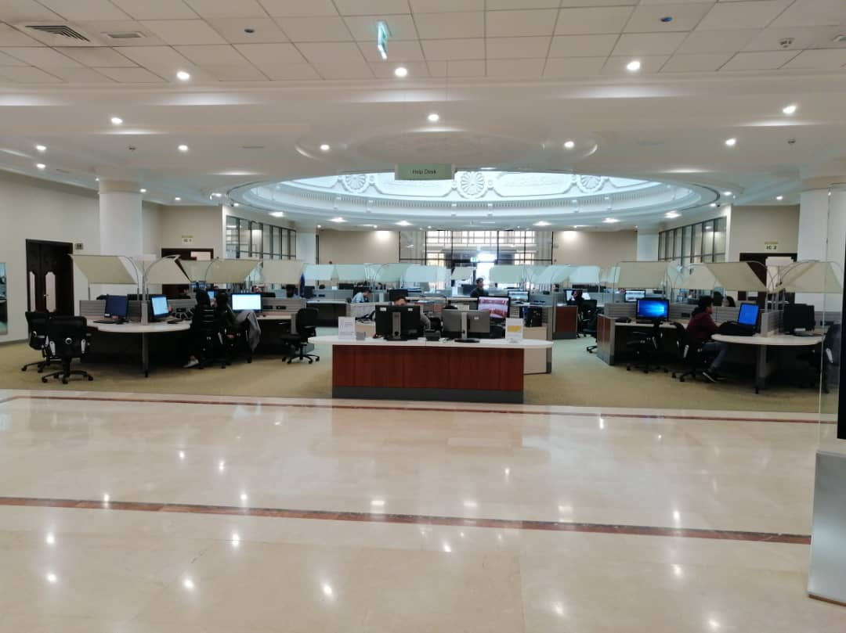
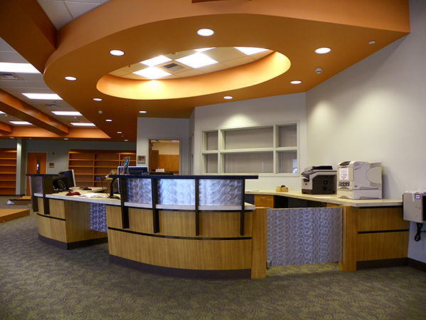
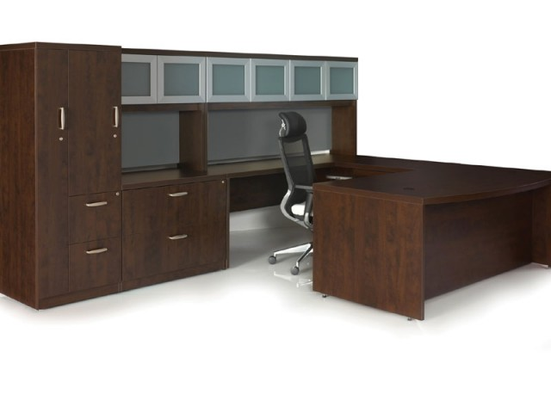
University libraries
2

Slide 3
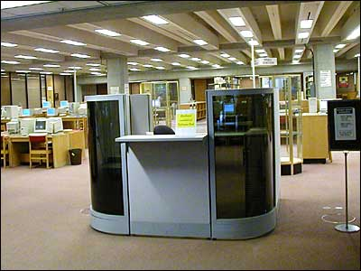
Information Communication Technology can be defined as the use of Information in order to meet human need or purpose with reference to the use of contemporary devices such as the internet and computer (Stosic & Stosic 2015).
WHAT IS ICT?
3

Slide 4

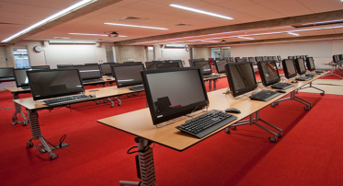
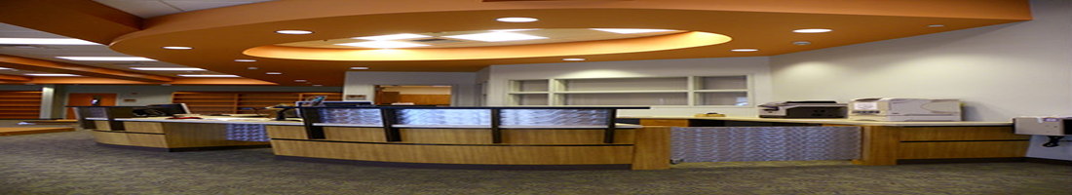
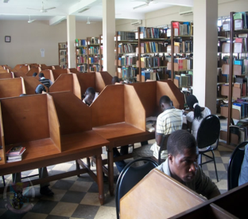
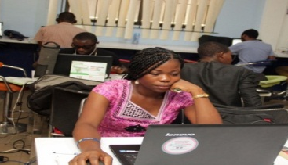
WHAT IS ICT?
ICT is defined as a variety of tools and technological resources used to communicate, create, disseminate, store and manage information (Bolu, 2011).
These technologies include computers, Internet, broadcasting (radio and television) and the telephone all are used for sharing of information.
Information and Communication Technologies consist of the hardware, software, networks, and media for collection, storage, processing, transmission and presentation of information
(voice, data, text, images), as well as related services.
(Tofi 2019).
4

Slide 5
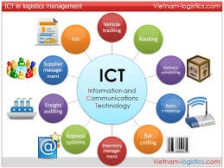

ICT
:
Alade (2006)
(Emezie & Nwaohiri, 2013)
Maa (2017)
King (2011)
Demson (2007) and
Nazim and muke (2016)

Slide 6
Take home points
6

Slide 7




Use of ICT make
7

Slide 8
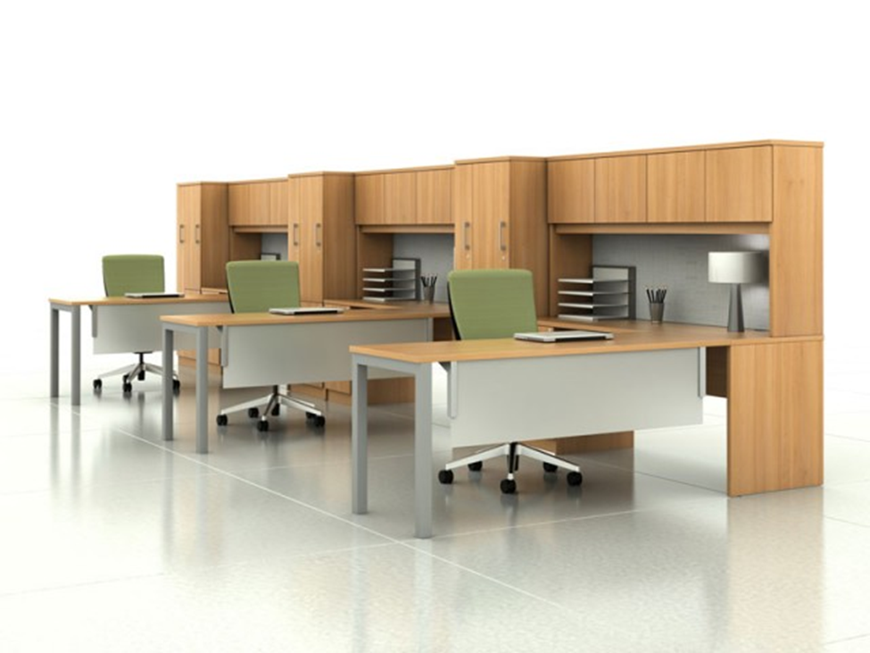

Use of ICT in University Libraries
8

Slide 9
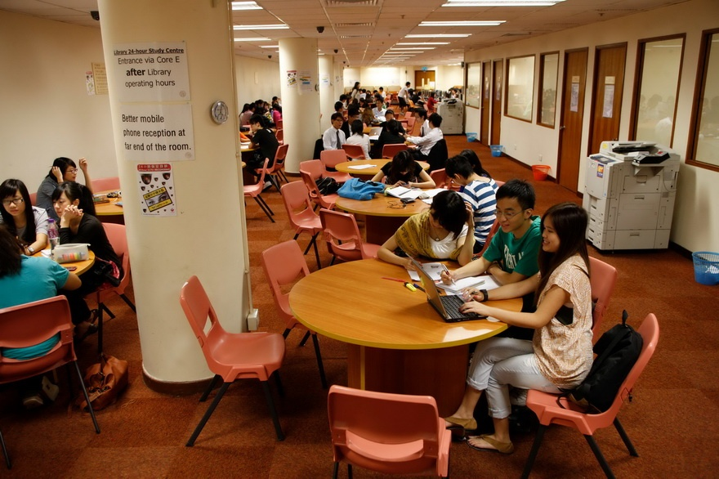

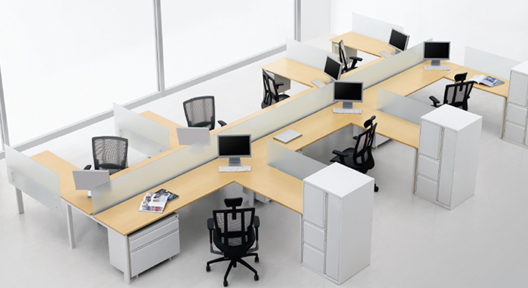
Studies have shown that
introduction of ICT facilities…
Dissemination of timely and up-to-date information is made easier
with the advent of these technologies which aid the transmission of information through ICT application.
9

Slide 10
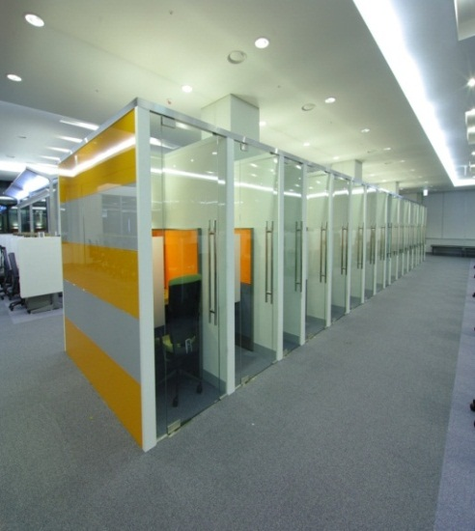
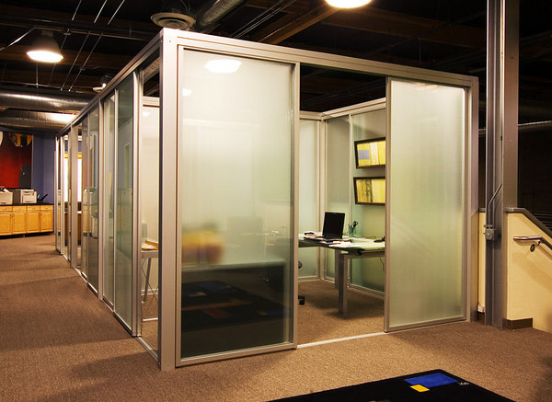
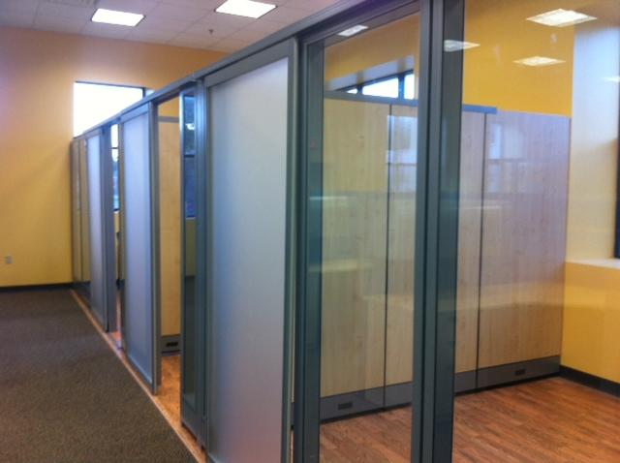
Rapid advancement of ICT has brought innovative changes in the university library
10

Slide 11




Use of ICT facilities
11

Slide 12
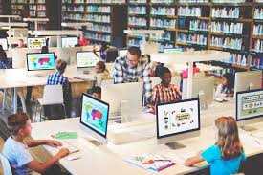
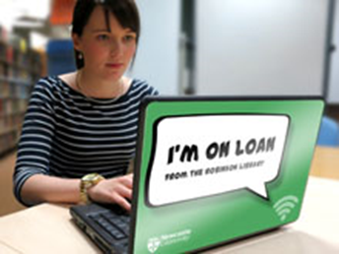
ICT
Use of ICT facilities
12

Slide 13
Take home points
13

Slide 14
GSM phone;
Projectors;
television.
ICTs Application as a tools for repositioning of Academic Library for Effective and Efficiency in Nigerian universities
Computer;
Video, film,
14

Slide 15


Lack of confidence in the face of increasingly information technology;
Information access;
Demands for new skills;
Lack of maintenance culture;
Cost / Funding.
Challenges of Using ICT as a tools for repositioning of Academic Library for Effective and Efficiency in the University Libraries.
Despite the enormous importance of using ICT in enhancing library services, this still poses a number of challenges which include:
15

Slide 16
Take home points
16

Slide 17
More take home points
17

Slide 18
Strategies for Effective and Efficiency use of ICT as a tools for repositioning of Academic Library in Nigerian
1.Adequate funding of university libraries;
2.Effective communication;
3. Adopting of good leadership style;
4.Recruitment of adequately skilled staff;
5. Training and retraining of library staff.

Slide 19

B. There is a mental development.
D. Students’ information and data are not in the danger of being lost easily.
A. Many people can be educated at the same time, if a meaningful result is obtained.
C. The world is becoming a global village with use of ICTs.
E. This increases our knowledge of these ICT applications.
Advantages
19

Slide 20
Disadvantages
1} ICT application make some people lazy and students stop reading the values in books AND some people use ICT to fraud.
2} Students crack their brains in order to manipulate the computer and execute their hidden agenda.
To a large extent, given the productivity of ICT in University Libraries, the advantage superseded the disadvantages. We can always combat the inconvenience of using computer applications, but we cannot avoid or prevent future benefits.

Slide 21
Conclusion
The most effective way to provide access to information in the university library is through subscription of databases, which can be done through ICT for enhancing learning, teaching and research activities of the university. ICT facilities are very important component of the university library recourse they support core functions of the university in terms of teaching, learning and research activities.

Slide 22

Way forward
A. Internet and computer skills must be made mandatory to keep students and lecturers in the right and proper pedestrian.
B. The government should be included in the budgets of funds that promote the purchase of ICT applications in the education sector in general and also in university libraries.
C. University and, people in the library should not siphon funds that are meant for the procurement of these ICT applications.
D. Adequate budgetary allocation should be provided by the government and administrators in order to meet up their financial requirement of the libraries.

Slide 23
What does this tell us?
1. How do we organize ICT applications to better support the university library services for sustainable development?
2. How do we demonstrate and value the ICT applications through impact and usage measurements?
3. How do we purchase good ICT applications in education sector in general and also in university libraries?
4. How do we capture & communicate the value of ICT applications within the university library services for sustainable development?

Slide 24
References
American Psychological Association (APA) 6th edition reference style was adopted

Slide 25



Sahabi, M. Kabir
(sahabikabir@gmail.com)
GSM: 08030807317
P
ACKNOWLEDGING WITH THANKS
Kaduna State University
(KASU), Tafawa Balewa Way, Kaduna Nigeria.
PP
PP
For listening
QUESTIONS?
COMMENTS?

