Slide 1
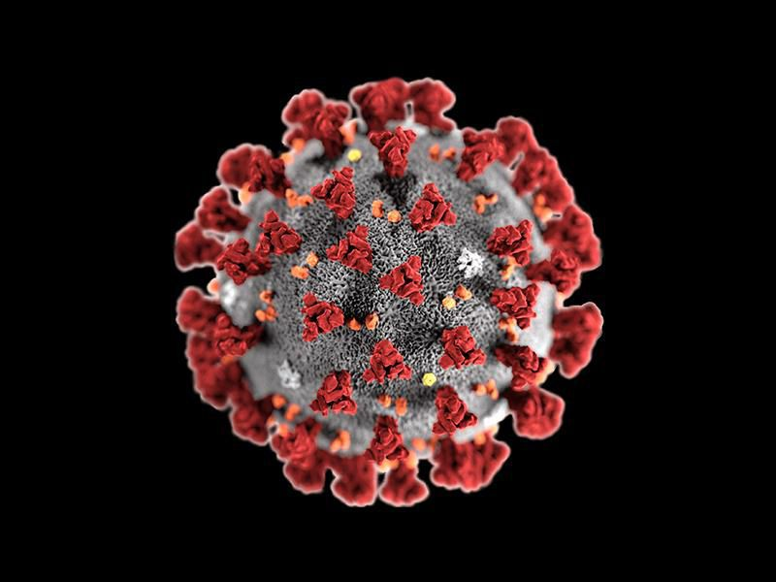
CoViD-19-AIMP: The New Normal
By: Professor Oludele AWODELE
Professor of Computer Science & Artificial Intelligence
Dean, School of Computing & Engineering Sciences
Babcock University

Slide 2
PRESENTATION OUTLINE
CoViD-19 in Summary
The Fractures of Losses
The New Normal
The Role of AI
Bringing it Together – AIMP
Conclusion

Slide 3
CoViD-19 IN SUMMARY
CoViD-19 is an infectious disease that is caused by a newly-discovered strain of Human Corona Viruses.
Evidences suggest that the Disease originated from a wildlife / sea food market in Wuhan, the Hubei Province of China – where symptoms were first noticed in December 2019.
Common symptoms of the Disease include: high fever, dry cough, and fatigue / tiredness; while other (not-as-common) symptoms include: aches and pains, sore throat, diarrhoea, conjunctivitis, headache, loss of taste or smell, and a rash on skin, or discolouration of fingers or toes.

Slide 4
CoViD-19 IN SUMMARY
More serious symptoms could include: difficulty in breathing or shortness of breath, chest pain or pressure, loss of speech or movement.
On the average, it takes 5–6 days after someone is infected with the virus for symptoms to show; however it can take up to 14 days.
CoViD-19 spreads primarily through droplets of saliva or discharge from the nose when an infected person coughs or sneezes. Hence, good hygienic practices (washing of hands, avoiding touching surfaces and ones face), and distancing between people are effective methods of preventing infection and spread of the Disease.

Slide 5
CoViD-19 IN SUMMARY
The World Health Organization declared CoViD-19 Public Health Emergency of International Concern (PHEIC) on January 30, 2020 – with 7818 total confirmed cases worldwide, and the majority of these in China. 82 cases had been reported in 18 countries outside China.
Research efforts are currently underway to manufacture a vaccine for the Virus; however, multiple expert reports suggest that an adequately-tested vaccine is not likely to be available until around early – mid year 2021.
As at the time of writing, there have been 9.1 million confirmed cases globally, with almost 4.5 million recoveries, and at least 470,000 deaths.

Slide 6
THE FRACTURES OF LOSSES
AFFECTING EMPLOYMENT, COMMERCE & INDUSTRY, HUMAN LIVES, GLOBAL ECONOMY, POLITICAL RELATIONS, EDUCATION, AVIATION & TOURISM, AND ENTERPRISE/BUSINESS.

Slide 7

SHUTTERING OF BUSINESSES
Many (non-essential) businesses were shuttered as part of efforts to cope with the spread of the rampaging Pandemic occasioned by the CoViD-19 Virus.
Essential businesses were forced to scale-down operations and limited interactions between people.
Businesses were also shuttered as part of measures to contain the spread of CoViD-19.
IMAGE SOURCE: GETTY Images / BBC.

Slide 8
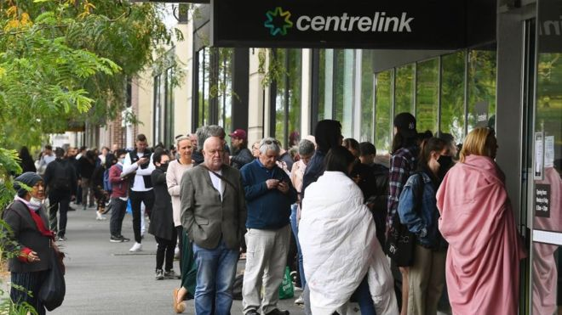
MASSIVE UNEMPLOYMENT
The shuttering of businesses was quickly followed by a massive rise in global unemployment numbers that reached tens of millions within only the first few weeks of Lockdowns.
Companies found it difficult to sustain employee capacity in the face of highly-scaled-down business operations.
Australians queue to receive unemployment benefits. IMAGE SOURCE: GETTY Images / BBC.

Slide 9
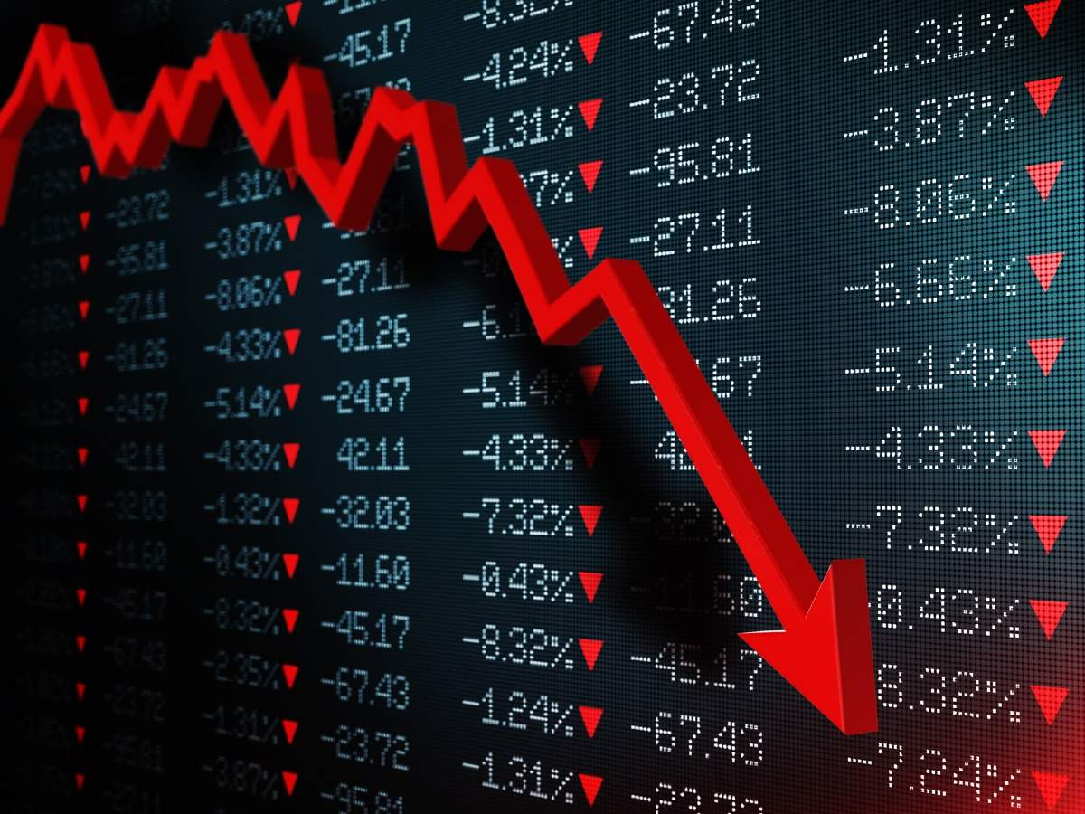
ECONOMIC DISTRESS
With prolonged lockdowns, and the national workforces at a standstill, the impact on the global economy was almost instantaneous.
Many developing countries have entered into recession, and some developed countries have been projected to follow suit in the coming weeks / months.
CoViD-19 puts the global economy in distress. IMAGE SOURCE: The Economic Times.

Slide 10
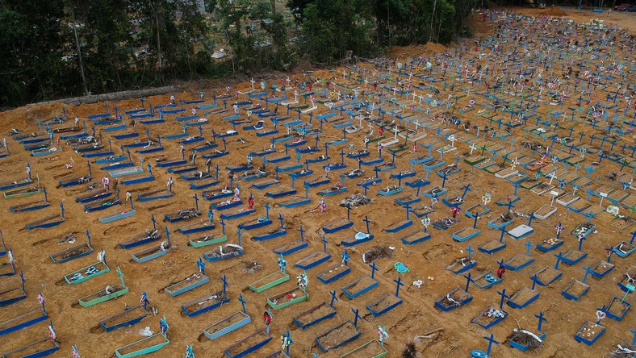
LOSS OF LIVES
The death toll from the CoViD-19 Pandemic is perhaps the starkest of the losses that have occurred.
In less than three months, millions had become infected and hundreds of thousands had died, as healthcare systems struggled to cope with rising statistics of infection and death.
Mass Graves in Brazil show the devastation caused by CoViD-19 to Human Lives.
IMAGE SOURCE: Reuters.

Slide 11

COMMERCE & INDUSTRY
The reduction in the demand for refined crude oil products as a result of the Lockdowns and restrictions in movement led to sharp drops in oil prices within few weeks of Lockdowns.
This plunged the global Oil & Gas Industry into distress, trying to deal with the logistics of storing and discarding excess crude oil products.
A Drop in Prices and Demand for Products puts the global Oil & Gas Industry in distress.
IMAGE SOURCE: Offshore Technology.

Slide 12
AVIATION & TOURISM
Following the declaration of CoViD-19 as a Public Health Emergency of International Concern (PHEIC) by the WHO in January, many countries were forced to close their borders and impose bans and restrictions of travels for their citizens.
This has a great impact on global Aviation & Tourism; with planes docked and airports empty.
Airport Queues are empty as flights are disrupted due to CoViD-19 Lockdowns and travel restrictions.
IMAGE SOURCE: Spencer Platt / GETTY Images.

Slide 13
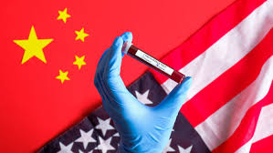
STRAINED POLITICAL RELATIONS
Experts worry that the CoViD-19 Pandemic may have strained an already fragile political relationship between the United States and China (from where the Virus is believed to have originated) for a long time to come. There are also fears that this situation may further affect political relations between the US and other countries in Asia.
Heightened Political Tensions between China and the United States in the wake of the Pandemic.
IMAGE SOURCE: Brookings Institution.

Slide 14
SHUTDOWNS OF SCHOOLS
The Government of the Federal Republic of Nigeria joined other world governments to mandate the shutdown of all educational institutions in the Country; as part of broader measures that were aimed at containing the spread of the Coronavirus Pandemic. Schools have remained shut for at least three months now, since late March.
Schools were mandated to shutdown as a measure to contain the spread of CoViD-19.
IMAGE SOURCE: Vanguard Nigeria.

Slide 15
THE NEW NORMAL
‘COVID-19 has been as disruptive as it has been deadly and devastating. The world as we knew it some months ago has changed, perhaps permanently. A new social, economic world order is gradually emerging. Vision planning will complement strategies planning. Our nation/Association must work towards being an active participant in this new order and new normal. The advent of COVID-19 has impacted our lives in ways never imagined.
SOURCE: CPN president address @ the CPN IT Assembly 2020
in the popular parlance, new normal is being defined and created, indeed, increasingly: Digital Communications, Virtual meetings, seminars and Conferences, Electronic/Online Learning, E-Commerce and E-government are becoming the new normal instead of default platforms.’

Slide 16
THE NEW NORMAL
SOCIAL DISTANCING: VIRTUAL CONFERENCES, ROBOTIC ATTENDANTS, E-LEARNING, AND WORK-FROM-HOME.

Slide 17

VIRTUAL CONFERENCES & MEETINGS
As part of efforts to comply with Social Distancing Guidelines and Regulations issued by governments and health authorities, many organizations are forced to go virtual for meetings and conferences.
This led to the popularization of platforms such as Zoom, Skype, WebEx, Google Meet, etc.
Conferences and Meetings have gone virtual, as part of efforts to comply with Social Distancing Guidelines & Requirements.
IMAGE SOURCE: iCohere.

Slide 18
ROBOTIC ATTENDANTS
There is also a growing adoption of robotic attendants to serve in the essential duties sectors due to concerns over public health and safety.
These robotic attendants have been seen in aged homes, supermarkets, hospitals, hotels, as well as quarantine & isolation facilities.
Robotic Attendants replace humans in many duties, due to public safety concerns.
IMAGE SOURCE: Shutterstock.

Slide 19
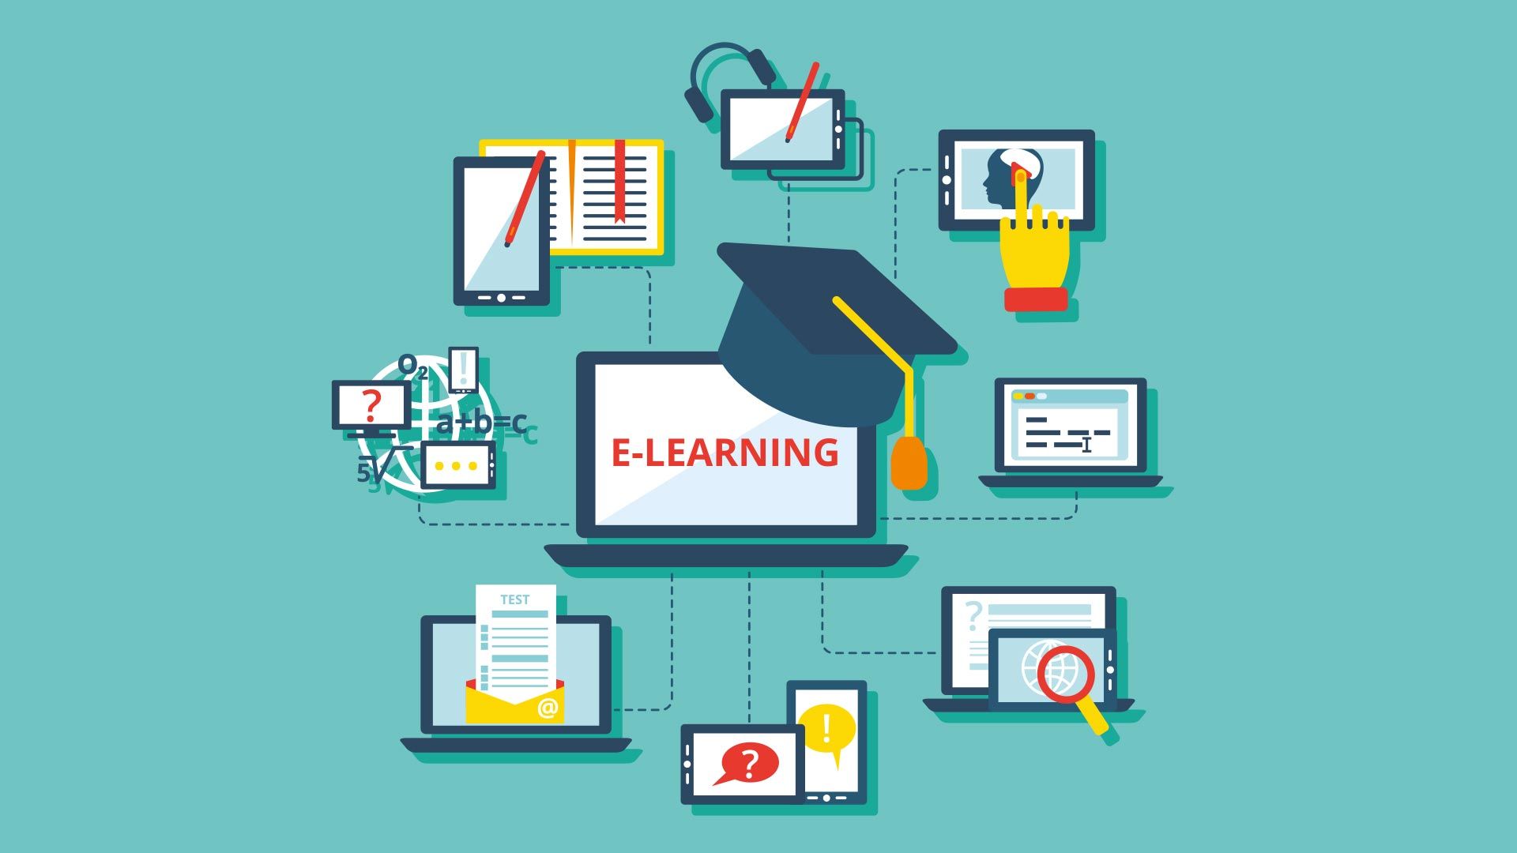
E-LEARNING
Because schools have been mandated to shut down, Educational Institutions turn to eLearning as part of efforts to continue regular curricular activities during the Lockdown.
Many platforms and approaches have been widely popularized as a result of this new reality.
Many Educational Institutions turn to eLearning as a way of coping with the shutdown of schools.
IMAGE SOURCE: GaussBox.

Slide 20
WORK FROM HOME
Also, Businesses and Enterprises have adopted robust work-from-home policies as part of efforts to remain in business and retain their essential workforce, while also trying to comply with Social Distancing Guidelines and Regulations.
Organizations adopt Work-from-Home Policies in efforts to cope with Lockdowns.
IMAGE SOURCE: Bloomberg.

Slide 21
THE ROLE OF ROBOTICS & ARTIFICIAL INTELLIGENCE
SECURITY & HEALTH MONITORING, TELEMEDICINE & MEDICAL EXPERT SYSTEMS, AND CONTACTLESS SERVICE DELIVERY.

Slide 22
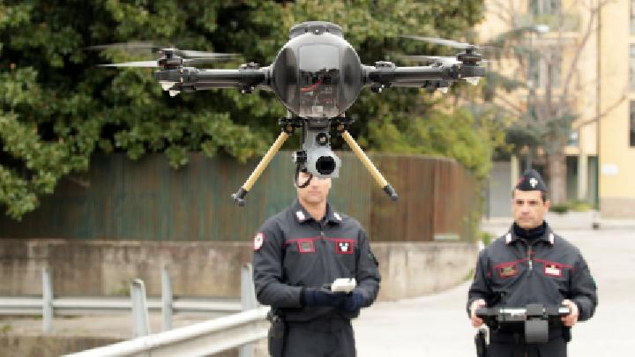
MONITORING
In the wake of the Pandemic, Drones were increasingly being adopted for Security Surveillance to enforce lockdown and restrictions; as well as for Health Monitoring in order to provide rapid response when necessary.
National Police Forces and Healthcare Facilities combines drone capabilities with handheld and wearable technologies.
Drones are being used for Security Surveillance, as well as for Health Monitoring & Response.
IMAGE SOURCE: REUTERS / Ciro De Luca.

Slide 23
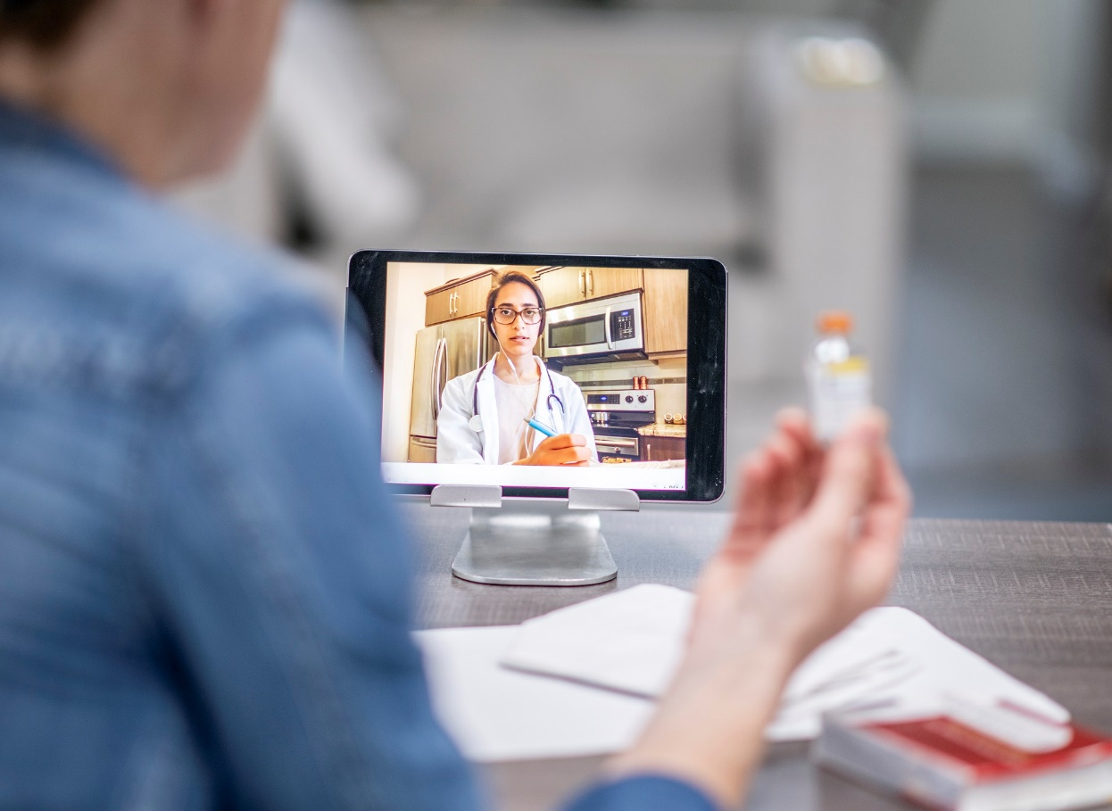
TELEMEDICINE
Also Telemedicine and Medical Expert Systems have been widely adopted and used since the peak of the Pandemic to support Healthcare Systems in service delivery by enabling activities such as self-diagnosis, expert consultation, guidance for administering medication, etc.
Telemedicine is used to enhance safe Healthcare delivery during the Pandemic.
IMAGE SOURCE: Haymarket Media, Inc.

Slide 24
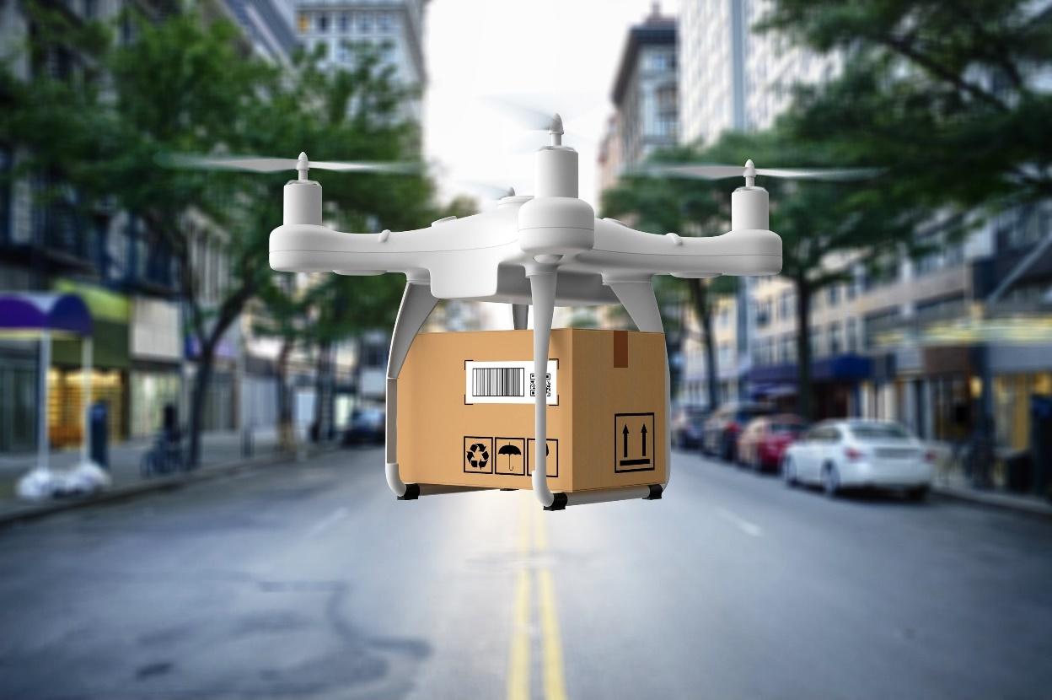
CONTACTLESS SERVICE DELIVERY
In the wake of the Pandemic, Drones were also used to detect virus infections in people, disinfect environments, as well as deliver packages of food and medical supplies to residences that were in Lockdown.
Drones are being used to safely deliver packages to people at their Residences.
IMAGE SOURCE: PRNewsfoto / Research and Markets.

Slide 25
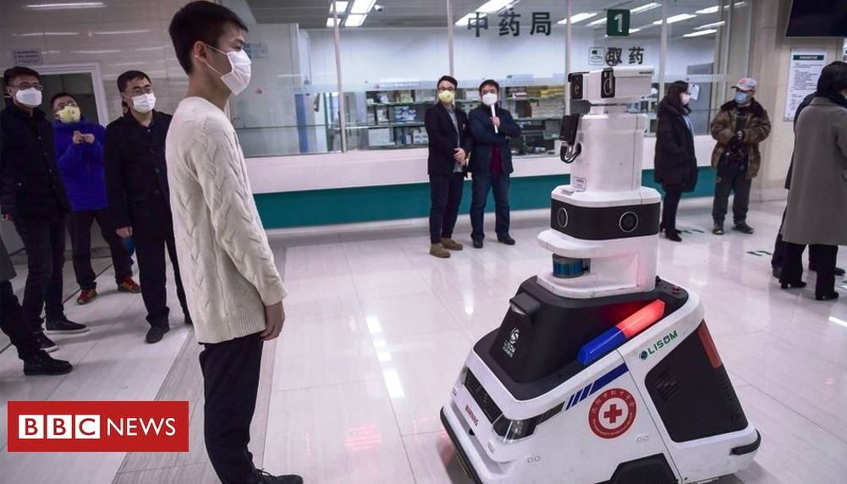
CONTACTLESS SERVICE DELIVERY
Furthermore, robots are used to scan people attending public places, and check for symptoms of CoViD-19; as well as support people in isolation and quarantine by delivering meals and interacting with them.
They were also used to remind customers of Social Distancing rules at public places like Malls, Parks, Beaches, etc.
Robots scan people to check for symptoms of CoViD-19, and also remind customers of Social Distancing rules.
IMAGE SOURCE: GETTY Images / BBC.

Slide 26
BRINGING IT TOGETHER – AIMP
Part of the goals of the Association of Applied Information Management Professionals (AIMP) is to leverage Information Technology and the resources that it provides, to deliver world class digital capacity building, training, and certification to Nigerian people and businesses.
There is therefore no better time for the AIMP to drive her Vision of producing “competent corporate IT Professionals that will transform the national economy through the application of cutting-edge knowledge of information management and its application to their organizational microenvironment” than now.

Slide 27
BRINGING IT TOGETHER – AIMP
Therefore, this is a call to all stakeholders of the Association of Applied Information Management Professionals (AIMP) to rise up and bind the wound that have been inflicted by the CoViD-19 Pandemic on the Nigerian Economy, and the Nigerian People; by harnessing the powers of Information Technology to provide the right solutions for this time of global need.
Of course, opportunities abound even in these times: for economic empowerment by providing cutting-edge digital services and solutions; as well as consultancy support in helping individuals and businesses to safely navigate through this difficult times.

Slide 28
CONCLUSION
As the world populations continue striving to adjust to “the new normal”, occasioned by the impact of the CoViD-19 Pandemic, I recommend that we use this opportunity as an association to make our impact in ‘producing competent corporate information professionals that will transform the national economy through the application of cutting-edge knowledge of information management and its application to their organizational microenvironment’. (OUR VISION)

Slide 29
CONCLUSION CONT.
AND remind us of OUR MISSION to:
Professionalize Information Management and raise Administrator with apt knowledge of data processing and management.
Train corporate leaders, administrators, managers and personnel who will sustain the new age.
Support humanity in its quest to change Cultural, Political and Socio-economical activities of all human race.
But then, I must welcome you all to “the new normal and the new order”.

Slide 30


