Slide 1
AIMP SEMINAR
Communication in a New Normal
By
Dr. Olutayo Ajayi

Slide 2
A New Normal: the resurgence of better communication?
Communication simply means of sending or receiving information.
Normal simply means conforming to a standard; usual, typical, or expected.
New Normal is a term used to reflect a change in society, particularly in relation to business and economics, that refers to significant change in financial and business conditions. It has been used following the COVID-19 pandemic.
Challenges posed by the coronavirus crisis will require companies to plan bold new strategies for internal communication.

Slide 3
Navigating the New Normal
The recovery strategy is two- fold. Firstly, it calls for strong leadership and credible communication, both internal and external.
The second part includes narrating the brands’ story with transparency and sensitivity to the current scenario.
The one thing brands and leaders do need to keep in mind is that there is no substitute for authenticity.

Slide 4
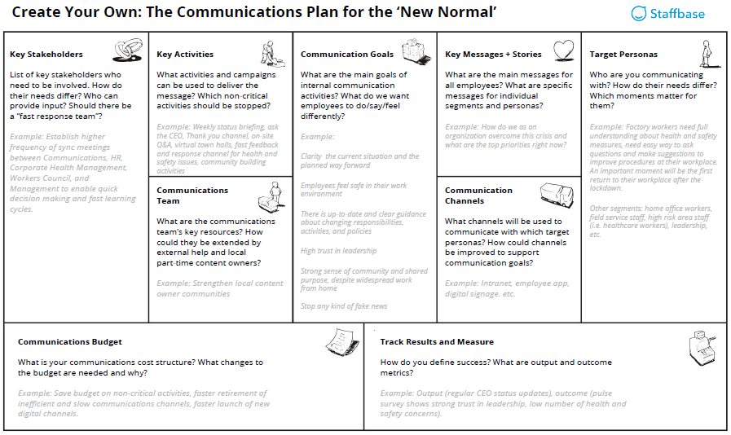
Template for Communication Strategy in New Normal – Courtesy Staffbase

Slide 5
Key Considerations for Effective Communication Over Video or Telephone
Preparing
  ensure clients can use the equipment.
Building Rapport and Trust
  spent time chatting about clients interests or background
Having the Conversation
  understanding and use of summarizing statements.
Responding to Emotion
  recognise heightened emotions

Slide 6
Key Considerations for Businesses
Clear, consistent messaging
  it’s essential that the message you are communicating right now is clear and consistent across every channel utilised.
Keep communicating
  you should prioritise communication as a key business goal
Adapt to provide alternative services
  Consider how you can be more flexible with some of the alternative methods.

Slide 7
Personnel Communication Model
Content Development
  content is best developed by a team.
Keep it simple
  bearing in mind that if your plans are too complicated, they will be impossible to understand.
Stay pragmatic
  ready to adapt your ideas as realistic and practical during implementation.
Print Ideas
  in large print and hang it on the wall for easy viewing

Slide 8
Team Communication Model
Keep Your Employees Engaged; Share News and Updates
Discover a better way of communicating
Your entire team in the loop with Paper Feed - channels
Create a group for every conversation
Integrate with the services you already use
Important files all in one place

Slide 9
Team Communication Model (cont.)
Secure Mobile Working - Anywhere, Anytime
  work safely from anywhere, anytime. i.e. TeamViewer app gives you secure remote access to networks, devices and files.
Maintain Your Productivity
  enable Remote Working‎
Remote Collaboration
  collaborate in Real Time

Slide 10
Clues for Enterprise Communications
Jobs can be done remotely
  jobs which hitherto assumed cannot be done remotely but must still be done
Serve customers in new, more flexible ways
  receive service without the need to visit a physical location.
Shape operational workflows and supply chain management
  increased their use of email and, possibly, workflow messaging tools such as WhatsApp or simple SMS texting.

Slide 11
Clues for Enterprise Communications (cont.)
Use of unified communications and collaboration
  managers and executives had to conduct business from a social distance
Advanced Planning of Communications tools
  proper checklists in order to protect information; what technology?; work for us?
Consumer technologies are increasingly important
  the “work from home” situation increases use of home tools
Automation
  less interactions with communication technology systems manually.

Slide 12
Communication Tools
Zoom
Zoom is a web video conferencing platform that a lot of teams use to hold meetings. It's one of the better substitutes for face-to-face interactions, and it's free to get started. You can also record and store meetings.
Features:
  Video conferencing + in-conference chat
  Screen-sharing
  Call recording
Cost: N5,900 - N7,800 monthly

Slide 13
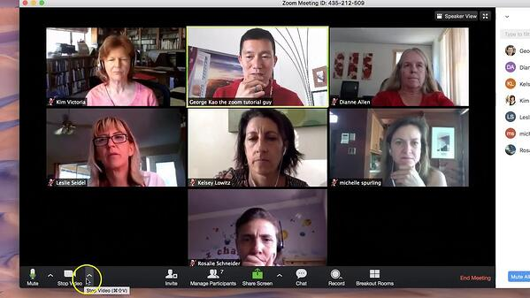
ZOOM PLATFORM

Slide 14
Communication Tools (Cont..)
Microsoft Teams
  Microsoft Teams, which is similar to Slack, is a collaborative communication tool where you can chat, create channels, and run your day-to-day correspondence.
Features:
  Integrations with other Microsoft tools
  Chat and messaging
  Audio calling
  Meeting scheduling (links to Outlook)
Cost: Free to sign-up

Slide 15
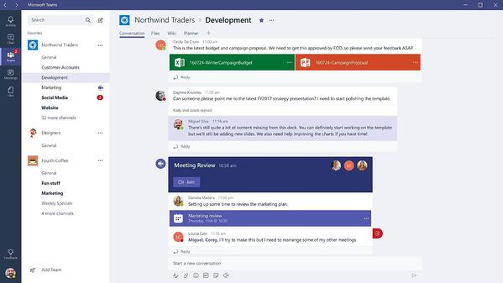
MICROSOFT TEAMS PLATFORM

Slide 16
Communication Tools (Cont..)
Google Hangouts
  Google Hangouts is a popular platform for communication. It's easy to start using, especially if you're already using Gmail and other Google Apps.
Features:
  Messaging and video calls
  Google application integrations
Cost: Free to sign-up

Slide 17
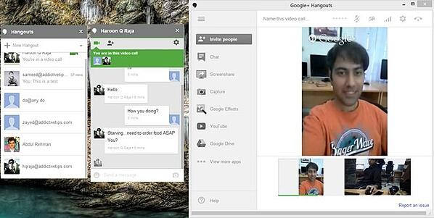
GOOGLE HANGOUTS PLATFORM

Slide 18
Communication Tools (Cont..)
Slack
  Slack, one of the best communication tools out there, is known for its intuitive UX. Many teams use it as a virtual HQ, and where they primarily share files and integrate tools.
Features:
  One-line messaging
  Ability to use integrations and plug-ins
  File-sharing
  Create separate channels
Cost: Free to sign-up

Slide 19
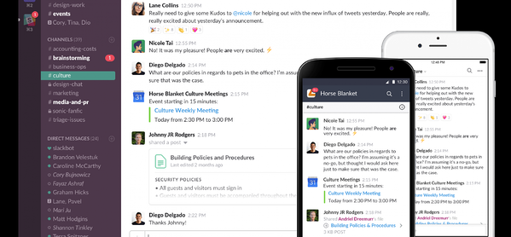
SLACK PLATFORM

Slide 20
Communication Tools (Cont..)
GoToMeeting
  GoToMeeting is a web conferencing tool specifically built for business. Users can collaborate effectively with clear audio, visual, and on-screen drawing tools, then later, use automatic transcripts for meeting notes.
Features:
  Video conferencing with 25 high-definition video feeds per session
  Chat
  Toll-free calling
  Personal meeting rooms
Cost: N5,500 - custom pricing

Slide 21
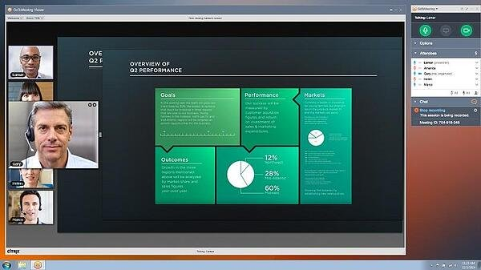
GoToMeeting PLATFORM

Slide 22
Communication Tools (Cont..)
Basecamp 3
  Basecamp (version three), is a massively popular project management tool. It's great for large teams with a lot of ongoing projects and tasks.
Features:
  Task management
  Chat and messaging
  File sharing
  Document management
  Milestone tracking
Cost: N38,400/month

Slide 23
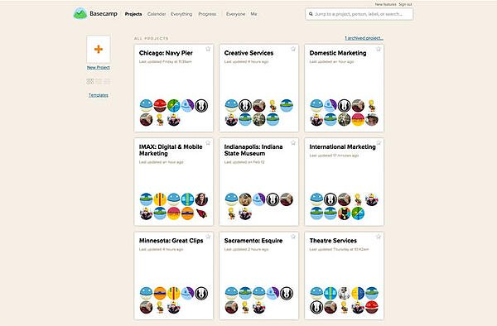
BASECAMP 3 PLATFORM

Slide 24
Communication Tools (Cont..)
UberConference
  UberConference is a free, minimal video conferencing tool for teams that need a no-frills, easy to use platform.
Features:
  Conference calling
  Screen-sharing
  Record and playback
  Mobile access
  No pins required to join calls
Cost: N5,900/month

Slide 25
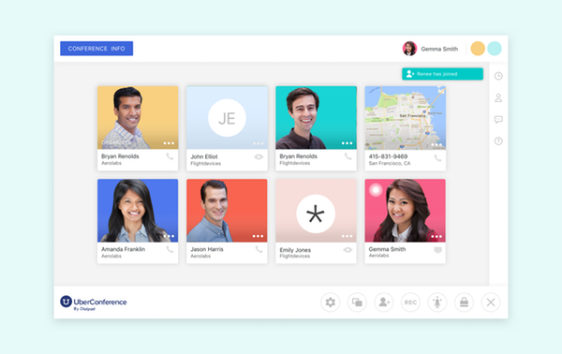
UBERCONFERENCE PLATFORM

Slide 26
Communication Tools (Cont..)
FreeConference
  Similar to UberConference, FreeConference is a pretty straight-forward web conferencing tool. You can get a link and join a meeting immediately, which makes it an ideal tool for people looking for something simple.
Features:
  Conference and video calls
  No hidden charges
Cost: Free

Slide 27
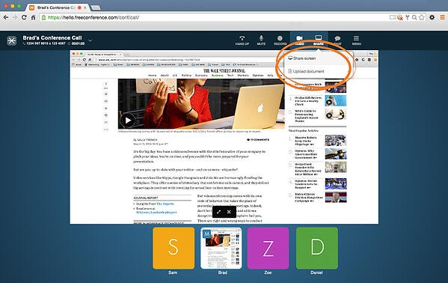
FREECONFERENCE PLATFORM

Slide 28
Communication Tools (Cont..)
Join.me
  Join.me is another straight-forward web conferencing tools with minimal features. You don't need to download any software — log in from your web browser and get started.
Features:
  Easy conference and video calling
  Screen-sharing
  Customizable URL and background
Cost: N4,700/month for lite

Slide 29
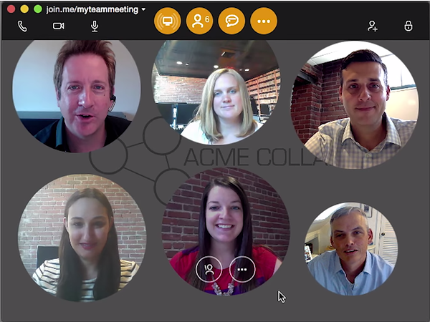
JOIN.ME PLATFORM

Slide 30
Adopting The Best Communication Tools For 2020 And The Future
The communication tools highlighted above are fine for remote teams that want to stay connected, although none are a substitute for the kind of fluid conversations that happen in an office. Imagine if you could virtually tap someone on the shoulder or approach a co-worker from anywhere in the world. It would make remote work so much more collaborative.

Slide 31
Thankfully, as current lockdown evolves — even more technology will emerge that makes your team feel like they're in the same room.

Slide 32
Ask yourself these key questions
What should you create?
How can you create it?
What channels to distribute it?
How to measure it?

Slide 33
Questions
Thank you for Listening

